Slide 1
NetSuite – най-бързо растящата облачна платформа за управление на бизнеса.
Владислав Живков
Cloud Forum Bulgaria 2016
14.04.2016
Notes:
DIRECTIONS:
Sales should put in the name of the prospect as the SUBTITLE (below “Where Business is Going”)

Slide 2
Agenda
NetSuite Inc.
Cloud or On-premise?
Tomorrow’s business
It Just Works
Q&A
Notes:
DIRECTIONS:
Would not expect there to be any changes on the agenda slide, but if there are, keep it to no more than 5-6 items at most

Slide 3
NetSuite Inc.

Slide 4
NetSuite History
1998 Founded by
Larry Ellison and Evan Goldberg
2000 First cloud
Business suite
2007 IPO on NYSE Ticker: N
2008/09
First global cloud ERP
First vertical cloud platform
2013 World’s most
deployed cloud ERP system
#1
Cloud ERP
Source: Gartner

Slide 5
The Undisputed Cloud ERP Leader
First Cloud ERP - founded in 1998
NetSuite Inc. (N) - NYSE
More than 4,700+ employees
Used by 24,000+ organizations
Used across 160+ countries
400+ new clients in the last quarter
Fastest growing top 10 FMS WW

Slide 6
NetSuite fourth quarter and fiscal 2015 financial results
31% Year-over-Year Increase in Q4 Revenue of $206.2 Million
33% Growth over Prior Year in 2015 Revenue of $741.1 Million
34% Growth over Prior Year in 2015 Operating Cash Flow of $100.4 Million

Slide 7
NetSuite Continues As Fastest Growing FMS
Revenue Growth for FMS 2013 - 2014
Research calculations show NetSuite is once again the fastest growing top 10 financial management system globally.
NetSuite Microsoft Sage SAP Oracle
Source: Gartner, “Market Share: All Software Markets, Worldwide, 2014” Published March 31, 2015. Chart created by NetSuite based on Gartner market share data.

Slide 8
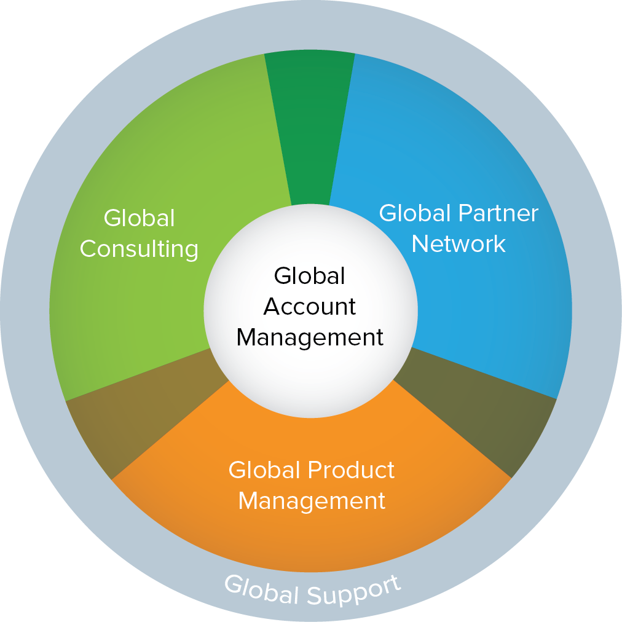
NetSuite – Your Global Business Partner
Global Offices
United States, Australia, Canada, Czech Republic, Hong Kong, Japan, UK, Philippines, Singapore, Spain, Uruguay
Global Development Organization
United States, Czech Republic, Philippines, Spain, Uruguay
Global Professional Services
Global Support
24x7, Follow-the-Sun, Multi-Lingual, CPA Qualified
Global and Regional Account Management
Global and Regional Product Management
Native Language, Cultural and Statutory Requirements Awareness
Global Partner Network

Slide 9
The Undisputed Cloud ERP Leader
NetSuite is the most successful ERP suite SaaS provider operating in terms of active customers, international presence and functionality offered across the product.
Event Note: Observations and Analysis From NetSuite's Global Customer Conference Analyst(s): Chris Pang, Robert P. Anderson, Christian Hestermann, June 2011

Slide 10
Balkan Services and NetSuite
Native cloud platform
Modern approach, cutting edge technologies
Rich set of functionalities, flexibility and adaptability
Fast growing platform and well adapted
Further development devotion
Permanent availability and strong security
Notes:
DIRECTIONS:
Replace Generic logo with the prospects company logo
Replace Generic headshots, name and title etc. with headshots, name, title etc. of each person from NetSuite on the call / in the meeting

Slide 11
NetSuite
Functionalities:
ERP, SRP, CRM, BI
eCommerce
Manufacturing
WMS
APC
OneWorld
HR
Marketing campaigns
Verticals:
Retail
Services
SRP
Advertising
Software
Wholesale and Distribution
Manufacturing
NGO
Notes:
DIRECTIONS:
Replace Generic logo with the prospects company logo
Replace Generic headshots, name and title etc. with headshots, name, title etc. of each person from NetSuite on the call / in the meeting

Slide 12
Cloud or On-premise?

Slide 13
On-premise vs. Cloud
•“On-premise”
•“Cloud”
e Constantly Evolving

Slide 14
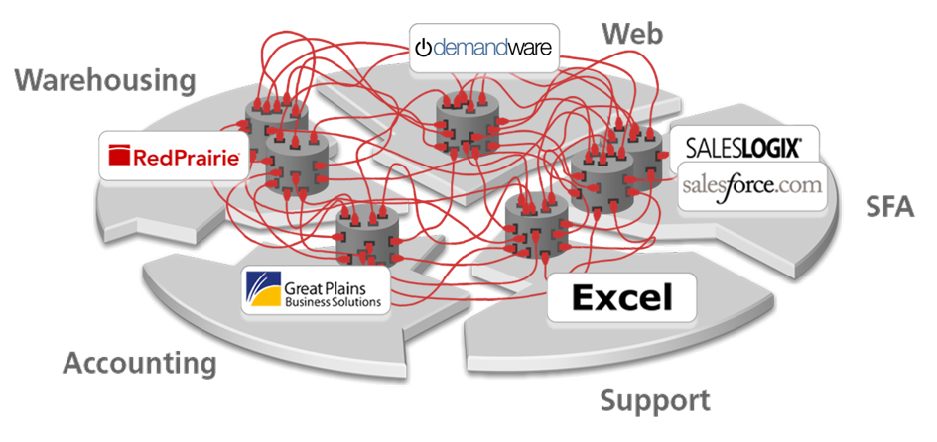
How Fragmented Business Systems might look like today

Slide 15
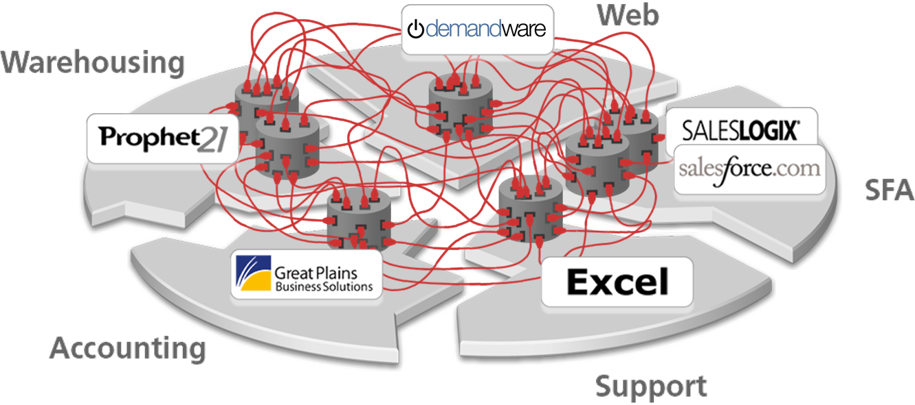
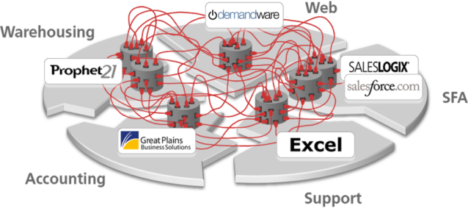
The global challenges are even greater

Slide 16
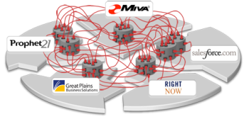
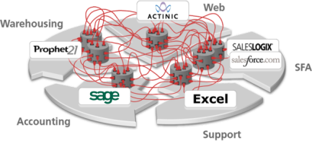
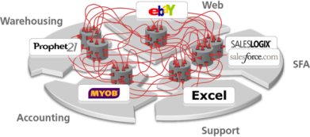
The global challenges are even greater
Worldwide HQ
GLOBAL
AMERICAS
EMEA
APAC
REGION
Canada
USA
Brazil
France
UK
Germany
Japan
Australia
China
COUNTRY

Slide 17
The world’s greatest multi-company, multi-currency system
GLOBAL
Worldwide HQ
SKR
AMERICAS
EMEA
APAC
REGION
COUNTRY
SKR

Slide 18
“Upgrade” is another Implementation
Approximately half of ERP customers are currently on releases that are two versions behind the current release, which may be four years old or more.
Trends 2011: ERP Customers Demand Better Flexibility, Cost Transparency, And Mobility

Slide 19
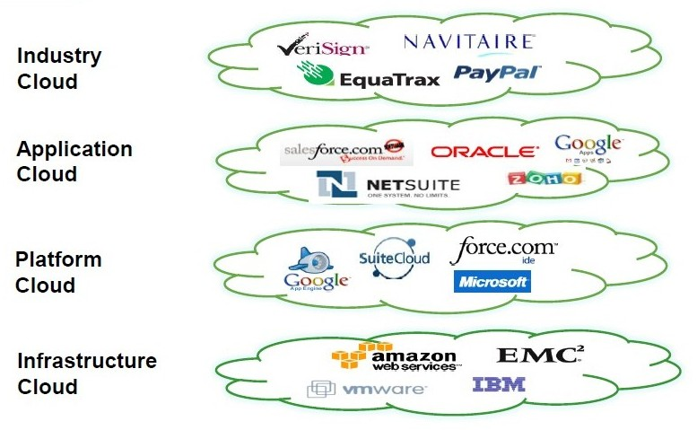
Cloud Variants

Slide 20
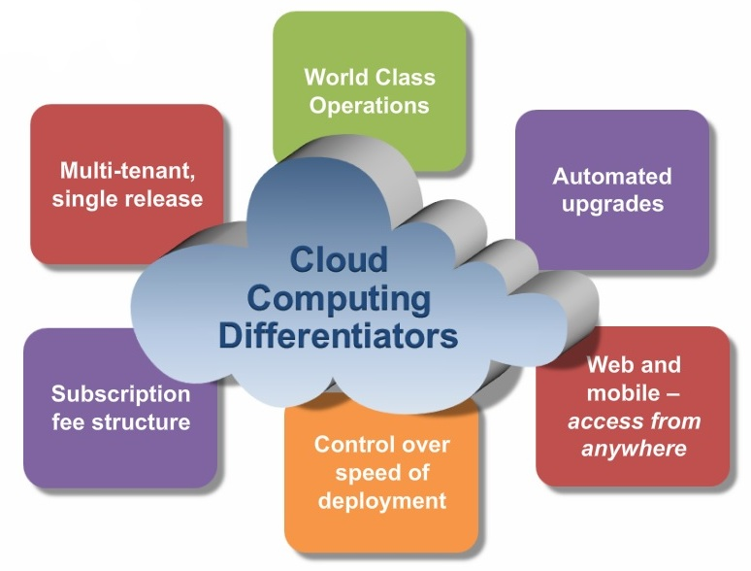
Cloud Computing Differentiators

Slide 21
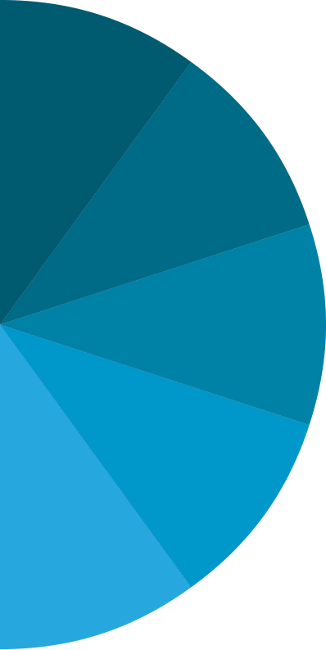
External Systems
Customers
CEO
ERP
SRP
CFO
WAREHOUSE
MANAGEMENT
PROJECT
MANAGEMENT
CORE BUSINESS
Shipping
Manager
CUSTOMER MANAGEMENT
ORDER MANAGEMENT
GLOBAL FINANCIAL MANAGEMENT
BILLING MANAGEMENT
REVENUE MANAGEMENT
Sales Rep/ Manager
INVENTORY MANAGEMENT
RESOURCE
MANAGEMENT
TIME &
EXPENSE
Merchandise
Manager
MANUFACTURING
Consultant/ PS Director
SUPPLY
CHAIN
MANAGEMENT
PROJECT ACCOUNTING
Vendors
Partners
Notes:
DIRECTIONS:
Adjust the names of the systems on this slide to more accurately reflect what you know of the prospects business / systems landscape. Also adjust the roles that would be interacting with the system to match the use-cases they would be most interested in, depending on their business type.
TALK TRACK (if pitching the Suite):
What you need instead to stay competitive in today’s world is a modern system that is designed more holistically around all your business processes.
From the core of your customer, financial and billing operations on out. [CLICK]
That allows you to manage all the components of your PRODUCT-based business – from manufacturing to inventory to distribution [CLICK]
In addition to your SERVICES-based business – from first bid to resource management to optimized billing [CLICK]
That allows all your internal stakeholders to easily access information in a way that’s tailored to their specific role [CLICK]
But its not just about your employees, its also about extending access out to your customers, partners and vendors as well as any external systems you may want to automate access for in the future.

Slide 22
5 Data Centers, 2 Regions
AMSTERDAM
DUBLIN
NORTH AMERICA

Slide 23
On-Premise associated costs (selected items only)
Hardware
Application Server(s)
Database Server(s)
Web/Communications Server(s)
Cabling, Racks
Routers & Switches
Disc Array
Test and/or Development Environment…
Software
Server OS Licenses
Database Licenses
Application Licenses
VPN / Citrix Licenses
Anti-Virus /SPAM /Firewalls
Back-Up Solution
Additional BI/Reporting Tools
Plant & Utilities
Server room
Security System
UPS
HVAC (heating, ventilating, and air conditioning)
Electricity
Insurance
Vendor Support
Annual Maintenance - Software
Hardware/Software Version Upgrades
Other Vendor Support needs
Technology Risks
Loss of Data
System Downtime
Technology Obsolescence
IT Support
IT Specialist / Team or
External IT Support

Slide 24
Tomorrow’s business

Slide 25
Today’s Constant State of Change
Business Models are Constantly Evolving
Agility is a Must
A Global View is Required
New Technology Impacts Expectations
Employee Engagement is Essential
Notes:
TALK TRACK:
Your business in the past was probably fairly predictable and stable… that is no longer the case today. In today’s world the only constant in business is CHANGE and you have to be agile enough to respond rapidly to changing market conditions before your competition does. For example -
New business models are emerging every day.
Companies that build products are morphing into delivering those products as a service. Companies that deliver a service are packing those services together to deliver them as a product. Manufacturers are going direct to the consumer (D2C) and looking more like retailers or distributors. B2C retailers are moving into B2B channels. B2B distributors are going online into B2C.
In this landscape, Agility is a Must
If you don’t have the ability to adapt, it can mean the difference between competitive differentiation, quality service, timely product offering or nimble decision-making and can have a major impact on your business. To operate successfully in a fast changing business and economic environments, your business flexibility is crucial.
To stay competitive, a Global View is Required
Whether you have international customers, warehouses, manufacturing facilities, or source raw material from global markets, you are operating in a global environment. With globalization, you need a strategy that allows you expand quickly and test your strategy before investing too much. You need to be able to quickly asses and understand local market conditions and adapt for the global impact those can have on your business. Again, change is the one constant.
And then there’s New Technology that Impacts everyone’s Expectations
Your customers expect to be able to reach you from their mobile phone, on facebook, on twitter etc. Your distributors are looking to engage with you the same way they shop on Amazon. Your employees are looking to be able to access corporate systems anytime, anywhere and from a myriad of smart devices. And who knows what’s coming next? The only thing that is certain is that new technology will continue to have a significant impact and you need to be able to future proof for what’s coming next.
Finally, Employee Engagement is Essential to continued success
As you expand globally and adopt new business models, your workforce is increasingly distributed and decentralized. You want to be able to source the best talent for the job from the most cost-effective geo without being hampered by the confines of the company firewall. The millennial generation entering the workforce demand easy-to-use systems that mirror social tools or online shopping and increasingly blur the lines between work and home life. At the end of the day, putting the right person in the right place with the right tools remains the best way for a company of any size to stay competitive.

Slide 26
Collaboration and Analytics are Central to ERP
More companies are interested in adopting:
Cloud – Deployments are complementary to on-premises apps
Mobile – Running ERP apps on a variety of smart devices
Analytics – Broadening their organization’s use of BI and reporting
Collaboration – Taking on technologies as part of a push for app usability
Business processes – Embedding processes within ERP apps
Source: Five Prevailing Trends In ERP
Notes:
TALK TRACK:
You don’t have to just take our word for where business systems of the future are heading.
Leading industry analyst firms such as Forrester predict that the prevailing trends in ERP systems in particular today are centered around being available via the Cloud, run seamlessly on Mobile devices, allow for actionable Analytics, foster Collaboration across the organization and span Business Processes across departments.

Slide 27
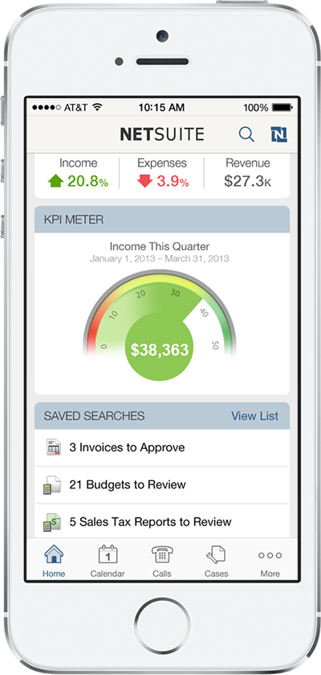
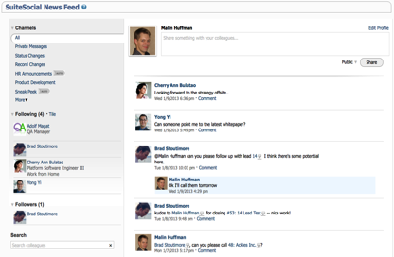
Designed for the Way You Work Today
Mobile
Social
Notes:
TALK TRACK:
With the average adult spending more than 60 hours per week on digital devices, traditional approaches to building business applications are doomed for extinction. NetSuite’s Mobile and Social approach to enterprise software goes beyond the post-PC world allowing you to check order status, check inventory, file your expense reports etc. on your favorite mobile device. Or collaborate across a globally distributed team with built in social tools.

Slide 28
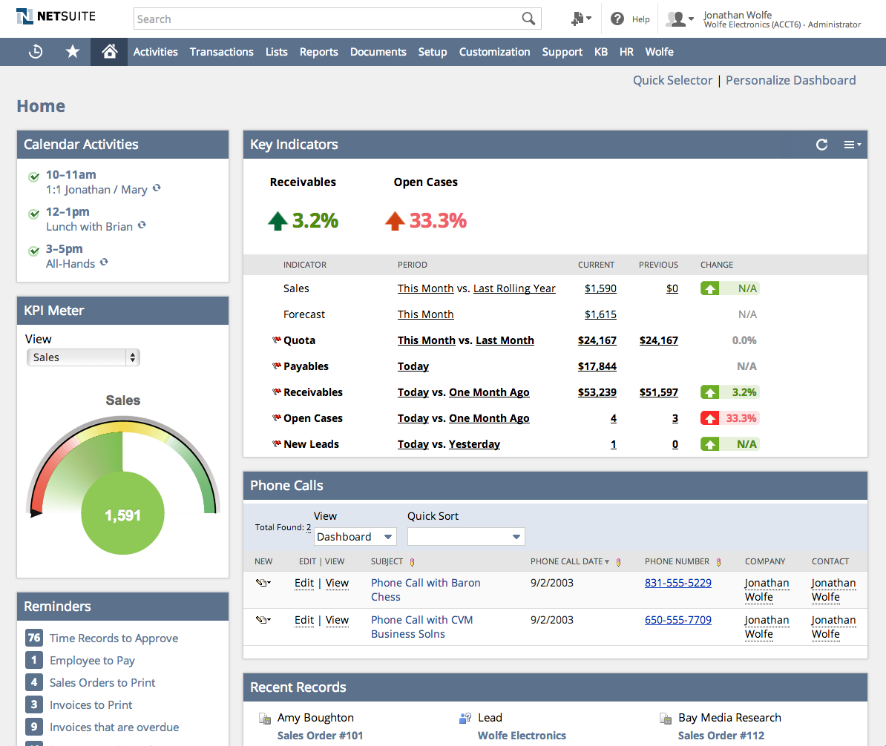
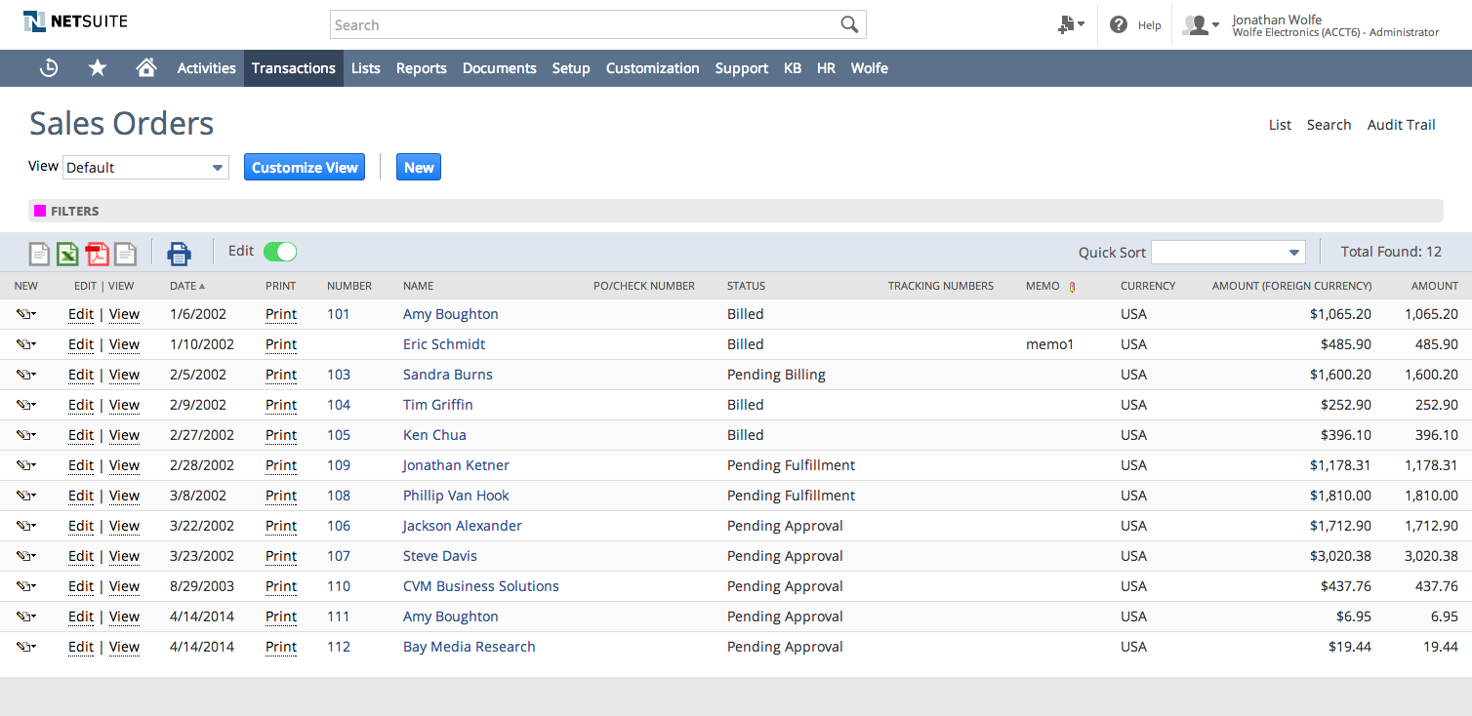
Easy to Use
Notes:
TALK TRACK:
With “The Consumerization of IT, expectations for business software have risen dramatically. Employee and customer expectations for an applications ease-of-use have forced companies to look for user friendly business applications. NetSuite’s modern browser UI bridges the gap between consumer application experience and robust business application functionality.

Slide 29
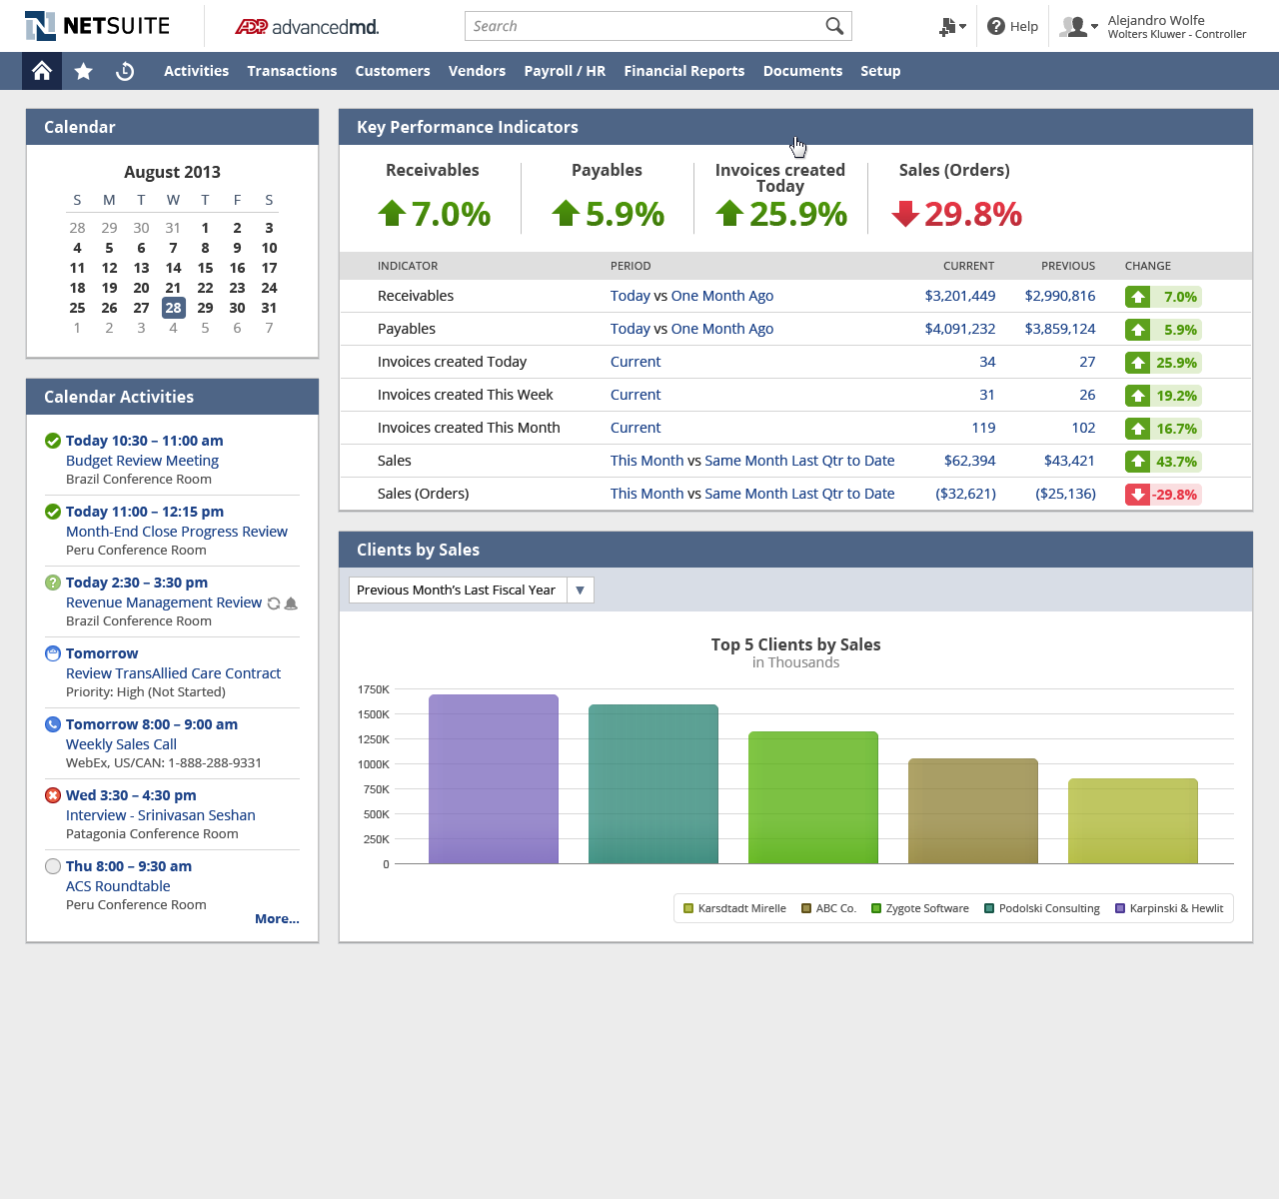
Business Intelligence for All – Finance Role Example
Notes:
TALK TRACK:
One of the big advantages of NetSuite is that you don’t need to have advanced technical skills in statistics to work with business information. Business users gain real-time visibility to identify issues, trends and opportunities and instantly drill down to the underlying transaction to take action.
For example, a Controller can easily address questions like how’s our billing efficiency? How profitable are we? Right from their Dashboard. They can drill into all the different business functions – financials, sales pipeline, HR – across different regions, while having a global consolidated view that helps drive strategic decision making.

Slide 30
It Just Works
Notes:
TALK TRACK:
As you can tell, NetSuite has proven time and time again to our customers that we deliver real value to their business

Slide 31
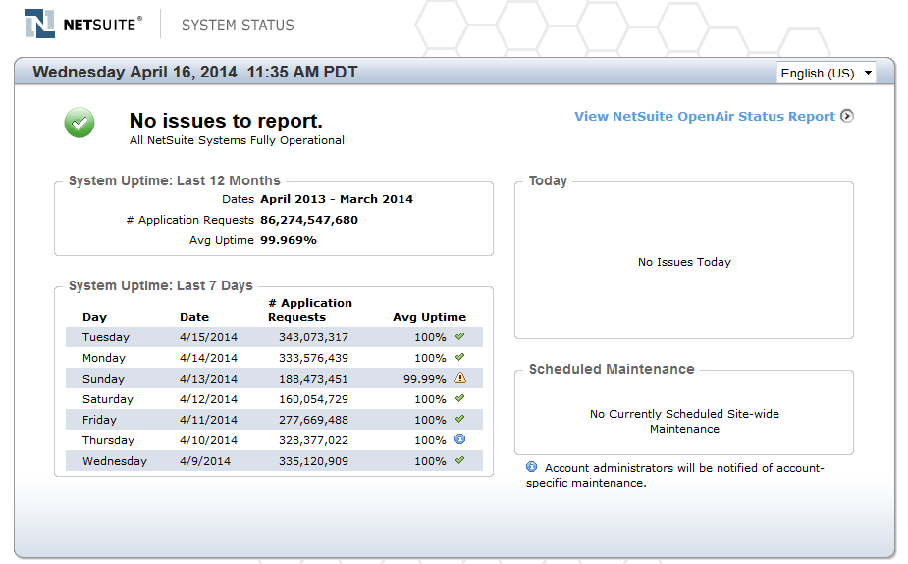
It Just Works – Secure and Reliable
World-Class Security
99.99% Actual Performance in 2015
Modern
Flexibility
Business
Intelligence
PCI DSS
Commerce- Ready
It Just Works
It Just Works
Notes:
TALK TRACK:
From a technology perspective, the three most important aspects that are important for any business’ success using a cloud solution, are Uptime, Security and Scalability. NetSuite offers certifications and SLAs to guarantee these key components.
From world-class mirrored datacenters with redundancy and disaster recovery plans, to industry leading security (ISO 27001, PCI, EU Safe Harbor), an uptime guarantee and an impeccable track record, NetSuite stands ready to deliver a reliable service that allows you to focus on business strategy rather than infrastructure.

Slide 32
In Last 12 Months, NetSuite Processed
Modern
25,248,436
130,288,511
17,362,538
Items/SKUs
Sales Orders
Purchased Orders
Flexibility
Business
Intelligence
115,496,926
1,554,564
$149,614,990,536
Commerce- Ready
Invoices
Services Projects
Amount of Sales
It Just Works
It Just Works

Slide 33
Largest Deployments
 | Transactions/Users | Platform
 | 1M+ Items/SKUs | 400 Custom Record Types
 | 100M+ Transaction Lines | 1000 Server Side Scripts (SuiteScripts)
 | 14M Records in Customer Account includes: Leads, Prospects, Customers | 10M/month Volume of Data In/Out via Integration (SuiteTalk)
 | 130 Subsidiaries Deployed
 | 1,000 Inventory Locations
 | 11,500 Users
 | 500K Invoices
 | 500K Financial Transactions per Day
 | 20K Transactions per Hour
Modern
Flexibility
Business
Intelligence
LARGEST
Commerce- Ready
It Just Works
It Just Works

Slide 34
Customer Success
 | Data | Throughput
 | Trillions of Business Records in Total | 300M+ Emails Sent
 | Billions of Custom Records | 60M+ Packages Shipped
 | Trillions of System Notes | 60M+ Unique Website Visitors
 |  | 2.1M Items Ordered on Cyber Monday
Modern
Flexibility
AGGREGATE
Business
Intelligence
Commerce- Ready
It Just Works
It Just Works

Slide 35
It Just Works – Proven NetSuite Benefits
40%- 70%
45%- 75%
10%-20%
Modern
Flexibility
Reduction in
financial close
Reduction in invoicing costs
Improvement in DSO
Business
Intelligence
45% - 75%
50% - 80%
45% - 75%
Commerce- Ready
Increased Order Processing efficiency
Increased in 360º Visibility
Reduction in IT Cost
It Just Works
Source: SL Associates and Customer Case Studies
Notes:
TALK TRACK:
Looking across the universe of NetSuite customers, you’ll see the proven benefits to business operations that can only come from a modern business system with built in flexibility, has Business Intelligence for all, that is Commerce-ready.
<sourcing notes>
20-50% - nucleus
25-75% - nucleus
DSO is from BearingPoint australia, and Peoplenet case studies
50%+ quote to cash (nucleus sofware piece) and audit prep
50%= IT costs, is from SMB

Slide 36
Demo

Slide 37
Q&A

Slide 38
Thank You

