Slide 1
Why Amazon Web Services? Bogdan Naydenov Certified Amazon Solutions Architect
14 Apr 2016 #cloudb2bmedia

Slide 2
Who am I
Bogdan Naydenov Senior IT Enterprise Architect - Telerik Platform Services team at Progress Software More than 18 years of IT experience with Windows/Linux system administration, infrastructure management, network & database management and design. Implementing DevOps practises
MongoDB DBA MongoDB Developer MongoDB Advanced Deployment and Operations
https://www.linkedin.com/in/bnaydenov

Slide 3
Disclaimer:
All views and opinions in this presentations expressed are my own do not represent my employer's view in any way.
I am not affiliated with Amazon Web Services in any way

Slide 4
March 14, 2006 was the day that Amazon Web Services (AWS) launched its first service, Amazon S3
10 Years in the Cloud
In the press release announcing Amazon S3 for the first time, AWS described its new service as "storage for the Internet." How much storage? The first objects were anywhere from 1 byte to 5 gigabytes, AWS said. And how much? At the time AWS charged $0.15 per gigabyte of storage per month and $0.20 per gigabyte of data transferred.

Slide 5
AWS named as a leader in the IaaS Magic Quadrant for the 5th consecutive year
More info: https://www.gartner.com/doc/reprints?id=1-2G2O5FC&ct=150519

Slide 6
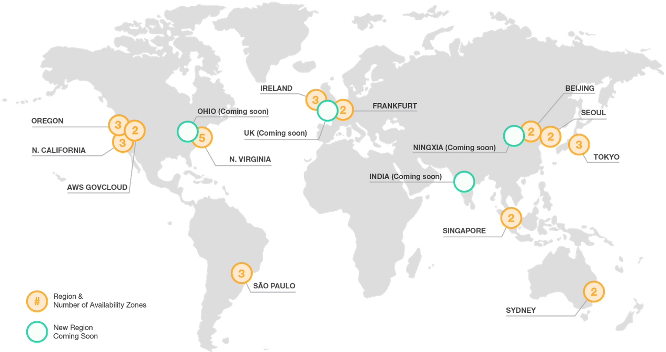
AWS Global Infrastructure
33 Availability Zones
12 Geographic Regions
Another 5 regions are expected to be added this year

Slide 7
AWS 54 Edge Locations
54: The number of global points of presence of AWS Edge locations, where Amazon CloudFront, Amazon Route 53, and AWS WAF services are offered.

Slide 8
AWS Customers from 190 countries
190: The number of countries where AWS active customers are from. The company has more than a million active customers including nearly 2,000 government agencies, 5,000 education institutions and more than 17,500 nonprofits

Slide 9
AWS 51 Price Reductions
51: The number of times AWS has reduced its prices since AWS launched (as of January 2016).

Slide 10
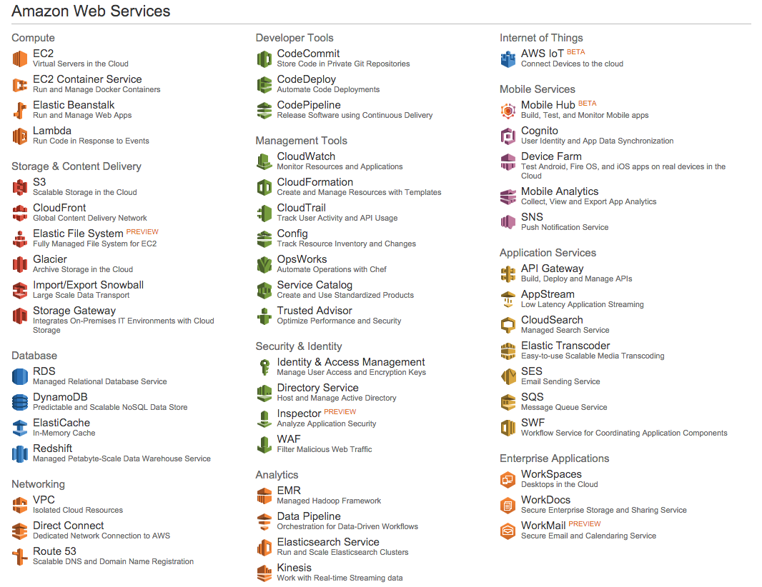
AWS more than 70 Services
AWS has more than 70 services that range from compute, storage, networking, database, analytics, application services, deployment, management and mobile.

Slide 11
AWS 722 New Services and Features for last year
40 percent: The increase of new AWS services and features, YoY, comparing 2015 to 2014. Last year, AWS launched 722 new services and features.

Slide 12
AWS - Aurora Fastest Growing Services
Amazon Aurora, a relational database engine, is the fastest growing service in AWS history.

Slide 13
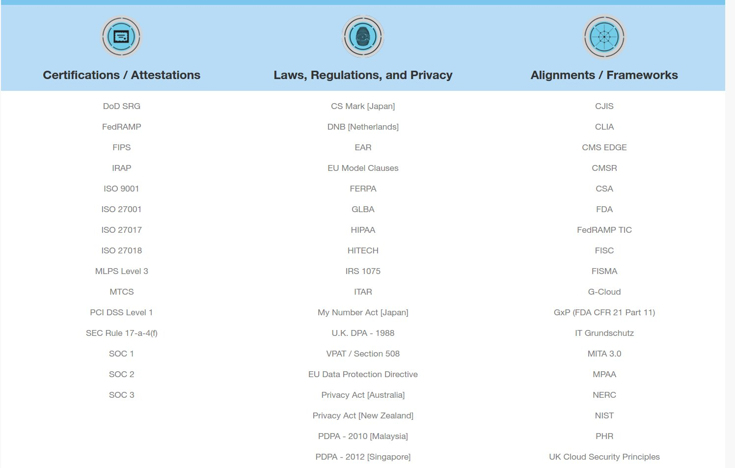
AWS Security and Compliance

Slide 14
Thank you Q & A
You can contact me at:
@BobbyNaydenov
https://www.linkedin.com/in/bnaydenov

Slide 15
Useful resources:
Gartner report https://www.gartner.com/doc/reprints?id=1-2G2O5FC&ct=150519
AWS Compliance Resources https://aws.amazon.com/compliance/resources/
AWS Whitepapers https://aws.amazon.com/whitepapers/
Case Studies & Customer Success Stories, Powered by the AWS Cloud https://aws.amazon.com/solutions/case-studies/

