Slide 1
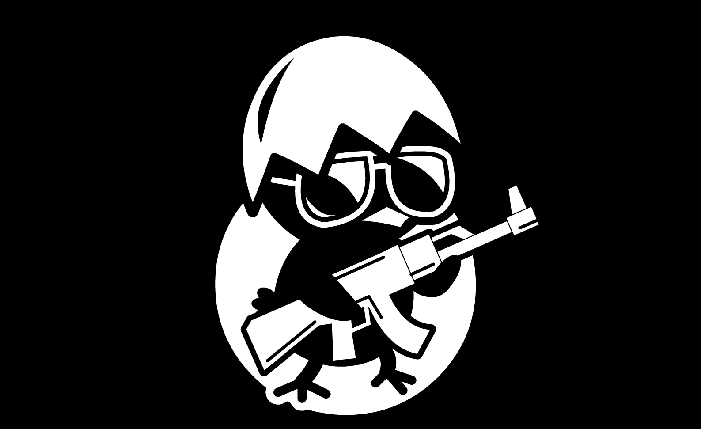
Mobile eSports (in the cloud)
Petar Dobrev, CTO and Co-Founder

Slide 2
eSports Overview

Slide 3
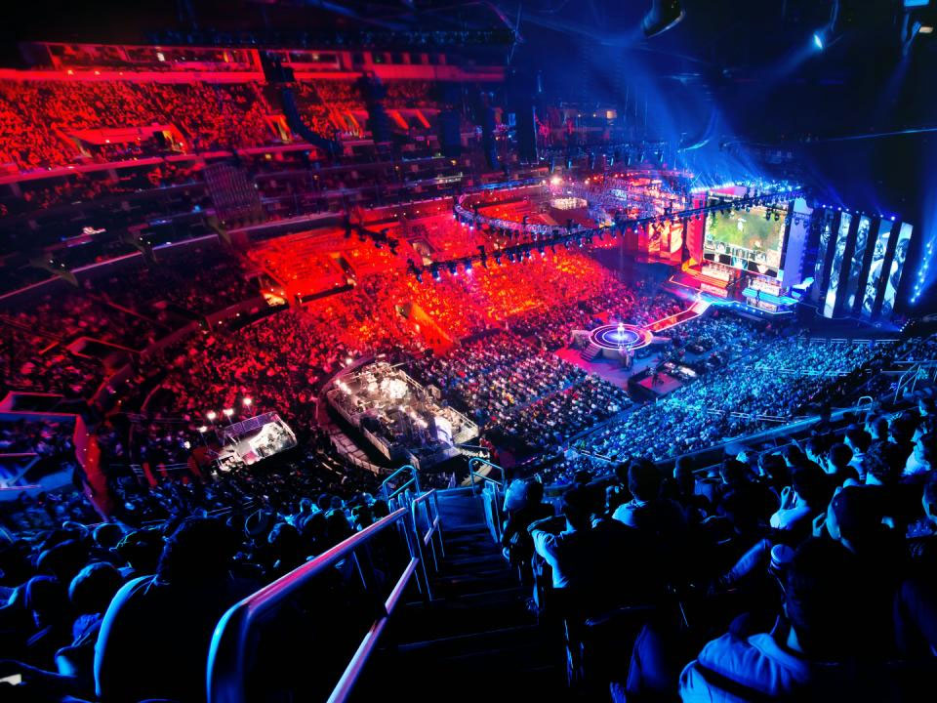
eSports = Competing Against Others in Real-Time Multiplayer Video Games

Slide 4
As PCs Matured in the Late 2000s, the eSports Industry Emerged
CPU performance gains
early 90s
DOS – Windows 3.1
late 90s Windows 95 - 98
early 2000s Windows XP onwards

Slide 5
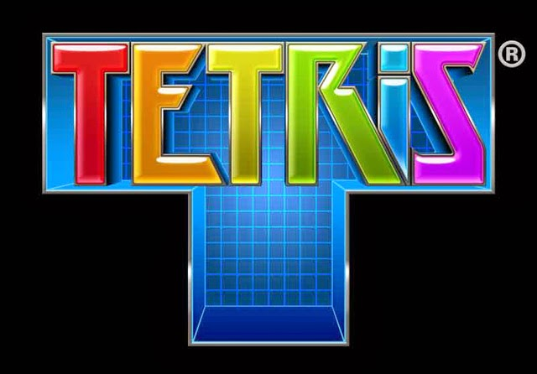
As PCs Matured in the Late 2000s, the eSports Industry Emerged
CPU performance gains
casual
Single player casual games
early 90s
DOS – Windows 3.1
late 90s Windows 95 - 98
early 2000s Windows XP onwards

Slide 6
As PCs Matured in the Late 2000s, the eSports Industry Emerged
CPU performance gains
midcore
Async
strategy
casual
Racing
Single player casual games
early 90s
DOS – Windows 3.1
late 90s Windows 95 - 98
early 2000s Windows XP onwards

Slide 7
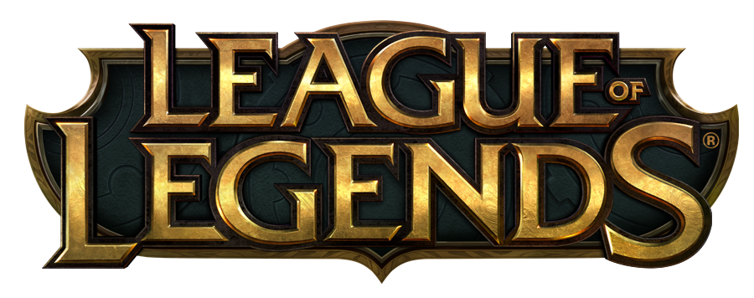
As PCs Matured in the Late 2000s, the eSports Industry Emerged
hardcore
MOBA
Sync strategy
CPU performance gains
midcore
Shooters
Async
strategy
casual
Racing
Single player casual games
early 90s
DOS – Windows 3.1
late 90s Windows 95 - 98
early 2000s Windows XP onwards

Slide 8
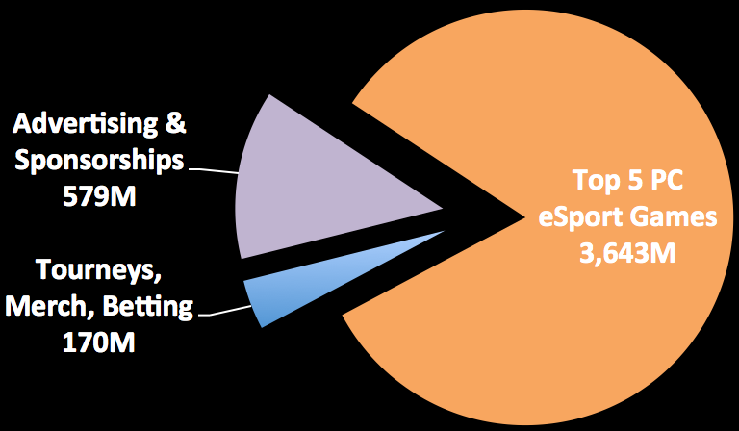
Today, eSports Franchises Capture 83% of the $4.4B PC eSports Market
Shooters (49%)
CrossFire ($1,110M)
World of Tanks ($446M)
Counter-Strike ($221M)
DOTA 2 ($238M)
League of Legends ($1,628M)
eSports Market
$4.4B (2015)
Strategy (51%)
Top 5 PC eSports
$3.6B (2015)

Slide 9
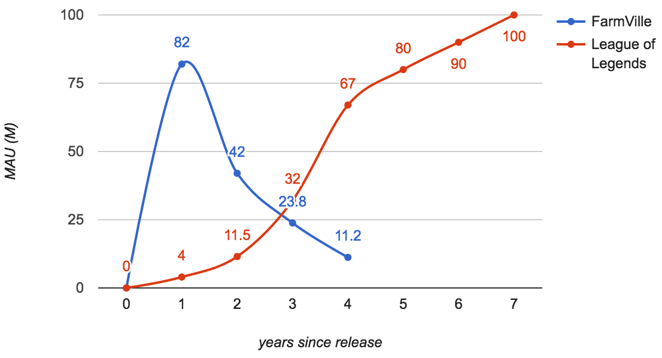
Casual Games ≠ eSport Franchises
18-24 months avg life, “kill time”
8+ years avg life, “master the game”
Casual games and eSport franchises are polar opposites

Slide 10
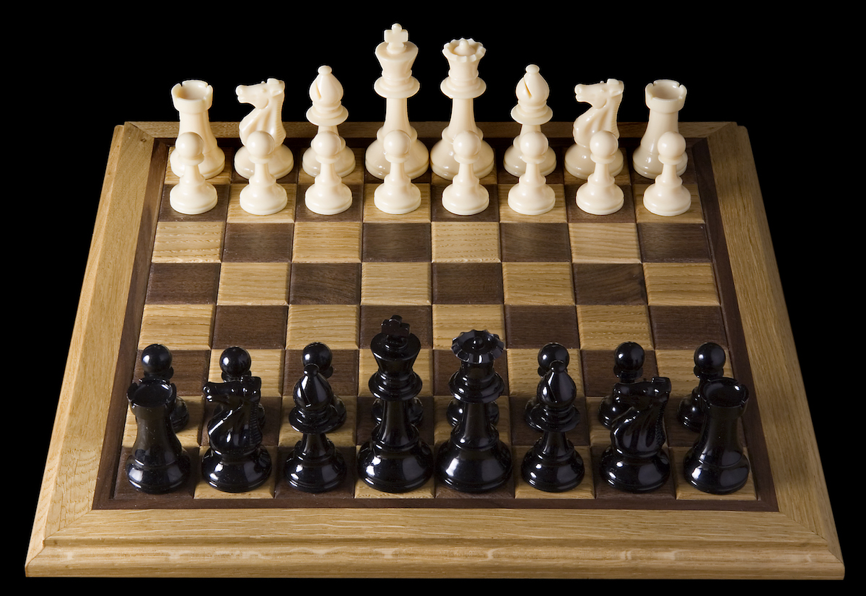
Like Chess, eSports are Compelling Because of Competition not Content Consumption
Despite only 6 unique pieces, chess provides infinite replayability

Slide 11
Competition Promotes Longevity
Shooters
Strategy
2014
Hearthstone (3 years)
2013
DOTA2 (4 years)
2010
World of Tanks (7 years)
2009
League of Legends (8 years)
2007
CrossFire (10 years)
2000
Counter-Strike (17 years)
1998
StarCraft (19 years)
Launch years and lifetimes for key shooter and strategy eSport franchises

Slide 12
Competition Creates a Moat: Strong Matchmaking-Based Network Effects
Match quality
matchmaking with roughly equally skilled opponents to ensure a fair & fun match
More players = better matchmaking = better eSports
Fewer players = worse matchmaking = worse eSports
Players
Note: network effects ≠ virality (although eSports have that too)

Slide 13
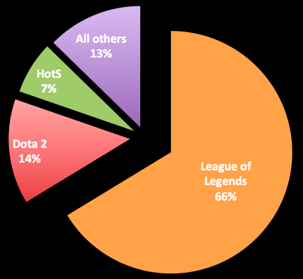
Network Effects = Natural Monopolies
MOBA market share (2016)

Slide 14
Mobile eSports Overview

Slide 15
Similarly to PCs, as Mobile Matures, eSports Has Emerged
iPhone CPU performance gains
2007
iPhone
2008
3G
2009
3GS
2010
4
2011
4S
2012
5
2013
5s
2014
6
2015
6s
2016
6+

Slide 16
Similarly to PCs, as Mobile Matures, eSports Has Emerged
iPhone CPU performance gains
casual
F2P casual games
Paid single player casual games
2007
iPhone
2008
3G
2009
3GS
2010
4
2011
4S
2012
5
2013
5s
2014
6
2015
6s
2016
6+

Slide 17
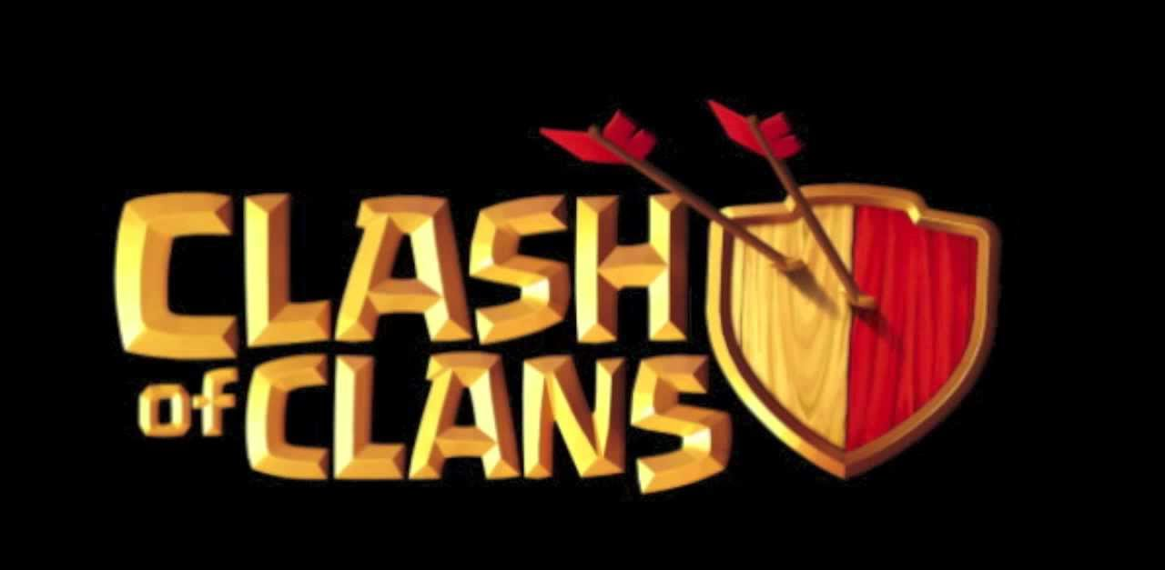
Similarly to PCs, as Mobile Matures, eSports Has Emerged
iPhone CPU performance gains
midcore
Async
strategy
casual
Card games
F2P casual games
Racing
Paid single player casual games
2007
iPhone
2008
3G
2009
3GS
2010
4
2011
4S
2012
5
2013
5s
2014
6
2015
6s
2016
6+

Slide 18
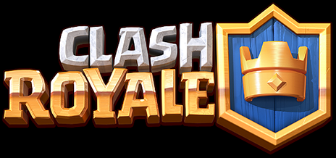
Similarly to PCs, as Mobile Matures, eSports Has Emerged
hardcore
iPhone CPU performance gains
MOBA
midcore
Strategy
Async
strategy
casual
Card games
F2P casual games
Racing
Paid single player casual games
2007
iPhone
2008
3G
2009
3GS
2010
4
2011
4S
2012
5
2013
5s
2014
6
2015
6s
2016
6+

Slide 19
Mobile Strategy eSports Hit $1B in 2016
Shooters
Strategy
Crisis Action ($18M)
World of Tanks Blitz ($37M)
Clash Royale ($591M) (9 months only, w/o Android China)
Crisis Action ($9M)
King of Glory ($326M) (iOS China only)
World of Tanks Blitz ($32M)
King of Glory ($11M)
Hearthstone ($143M)
Hearthstone ($50M)
Top Mobile eSports
$103M (2015)
Top Mobile eSports
$1.1B (2016)

Slide 20
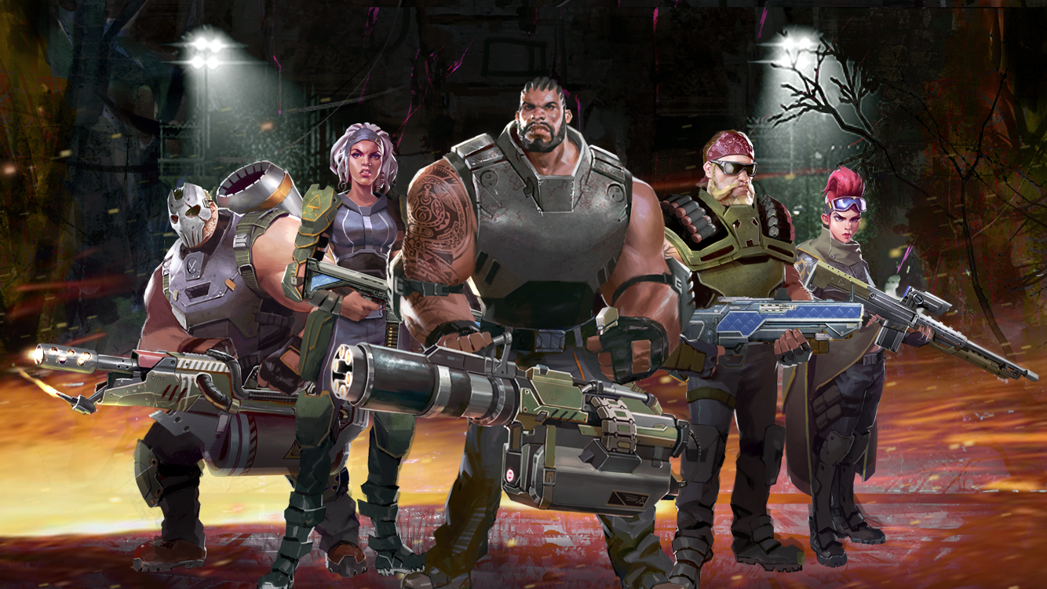
Our Mission: Turn Mayhem Into the Mobile eSports Shooter
As featured in:

Slide 21
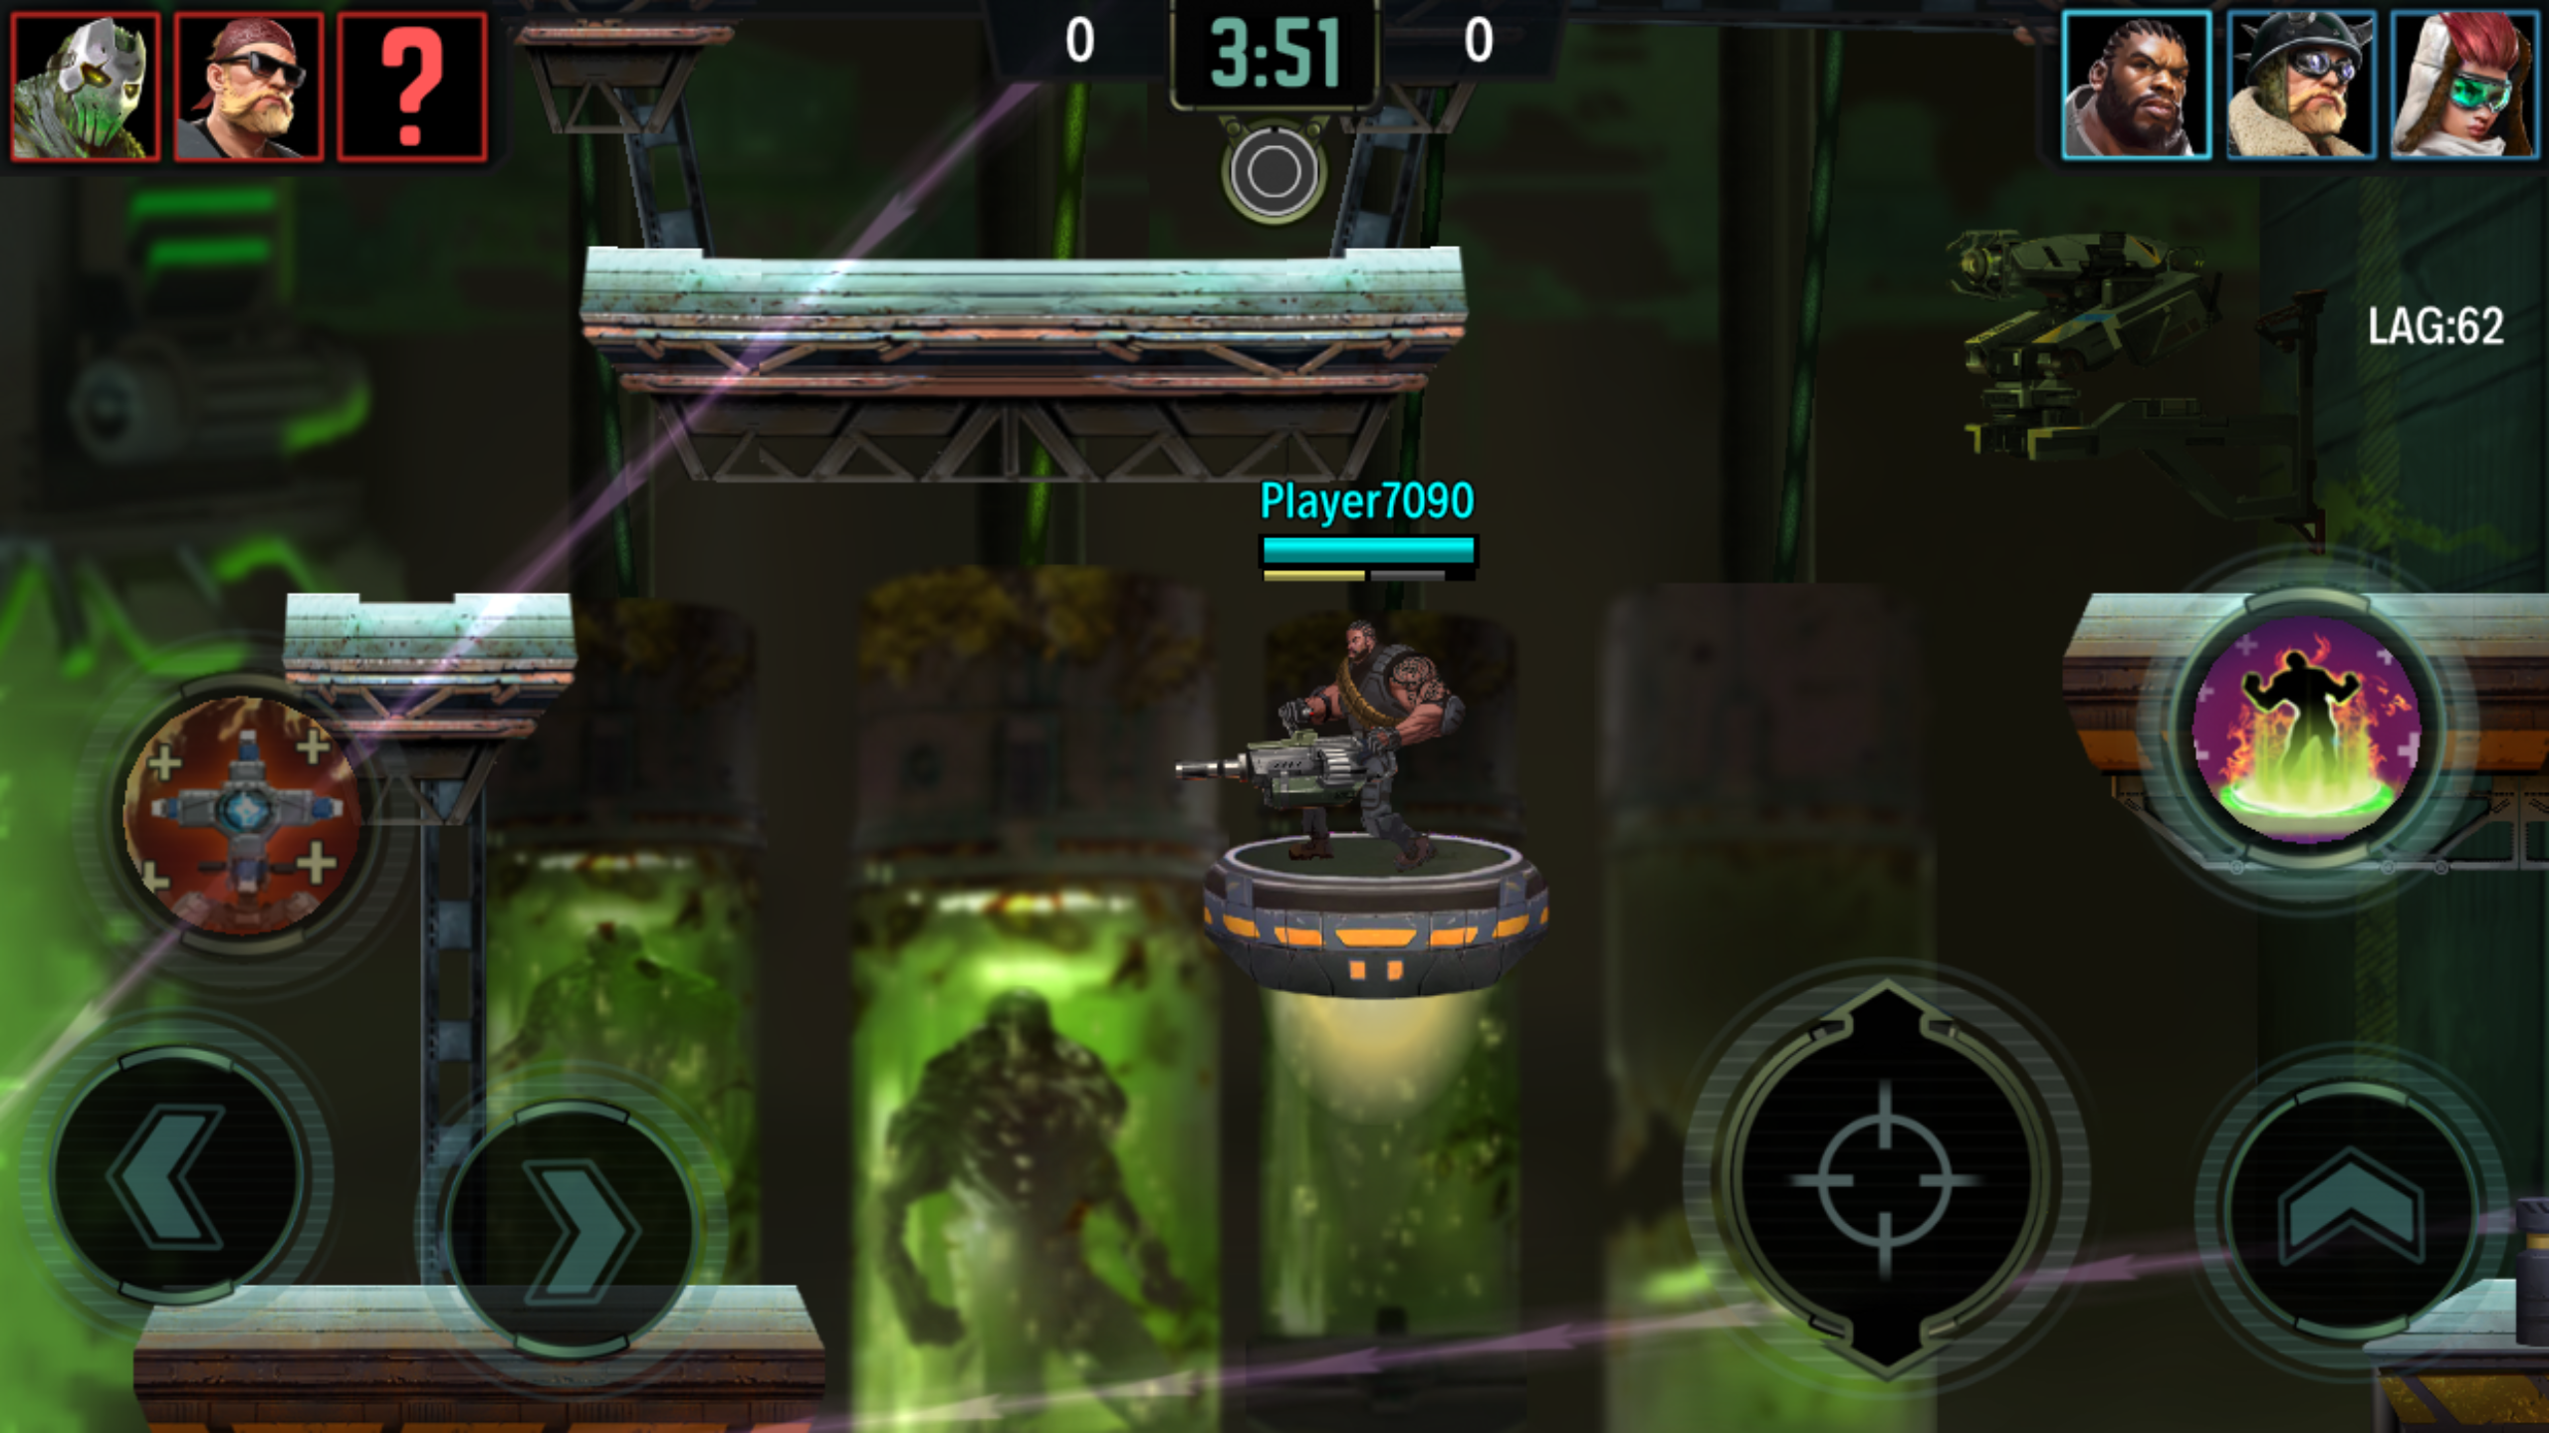
Mayhem 3v3 side-scrolling team action

Slide 23
Mayhem Multiplayer
Mayhem uses a client-server multiplayer model for real-time action, based on the work of Quake 3 and DooM 3, heavily modified for mobile
Built on top of a proprietary engine to best support the multiplayer model

Slide 24
Chobolabs at a Glance
26-person team split between:
San Francisco: product, art, design, marketing
Sofia, Bulgaria: engineering, tech art, QA
Founded in 2013, backed by top-tier investors

Slide 25
Backend infrastrcture
Microservices oriented architecture
Metagame
User auth, “business logic”, etc.
Matchmaker
Find the best possible matches based on user skill
Game servers
Where the actual games are hosted

Slide 26
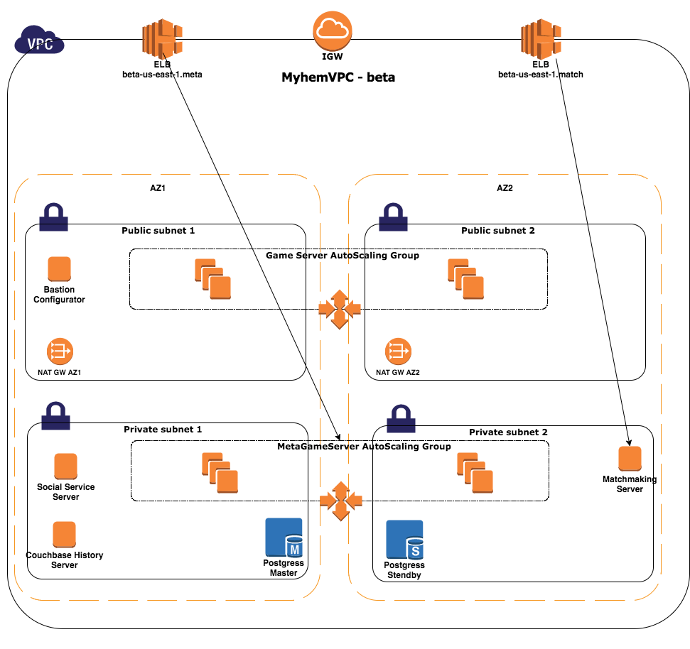

Slide 27
Cloud Benefits
High availability
Multi-AZ deployment over ELB
Trivial auto-scaling of game servers
Easy deployment in new territories
Multiple test environments
Dev-bg, dev-us, staging, feature branches
Game assets and server slugs deployed via S3 (which never fails)
Pay for what you use

Slide 28
Thank you!
If you are interested in keeping up with Chobolabs and Mayhem, please follows us at:
www.chobolabs.com
www.playmayhem.com

