Slide 1
Cloud & Blockchain Tech Forum
B2B Media
Емилиян Енев, съосновател на ReCheck.io
София, 30 март 2018

Slide 2
General results expected
from blockchain solution
Speed (end-to-end automation)
Reduced costs (sending nearly infinite amounts of data to giant processing facilities)
Increased revenue and efficiency (freeing up excess capacity for reuse)

Slide 3
General results expected
from blockchain solution
Increased security and integrity (trust is designed into the network infrastructure)
Increased privacy protection (intermediary can’t override or ignore rules defined in blockchain)
Improved understanding of underlying processes and strengthened predictive capability

Slide 4
When to use blockchain
When organizations and people that
do not know or trust each other need
to interact

Slide 5
When to use blockchain
When we want to provide secured
shared access to same data

Slide 6
When to use blockchain
When we want to protect data against
tampering, modification or deletion

Slide 7
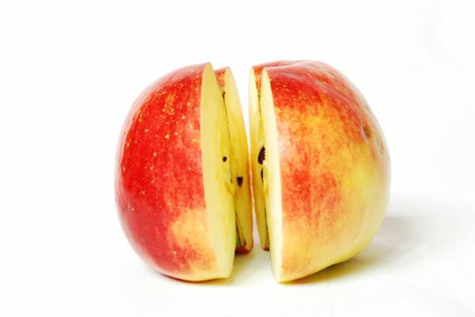
When to use blockchain
When we want to exchange value
directly and quickly
When we want to distribute value
in fair and transparent way

Slide 8
When to use blockchain
When you want to comply with new
regulations and laws (especially in the
field of data protection)

Slide 9
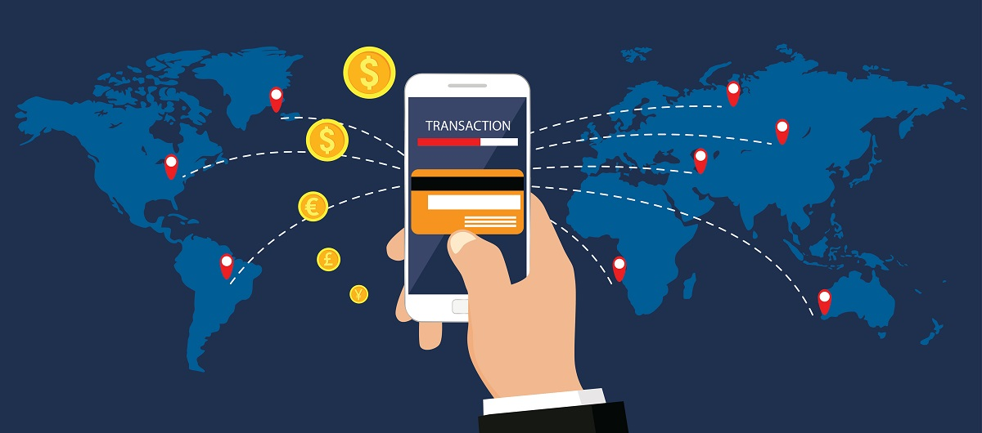
When to use blockchain
When you want to do precise
tracking and have full traceability

Slide 10
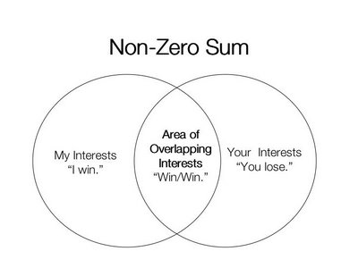
When to use blockchain
Escape the zero sum game.
Aim at positive sum game.

Slide 11
When to use blockchain
Do no reproduce existing processes on blockchain. Re-think, re-ingeneer and re-build

Slide 12
New business models
Different prices based on reputation and past transactions on blockchain.
Return on data provided to the network.
Incentivizing honest behavior and contributions.
Digital life of physical products.
Building trust with validated digital facts.

Slide 13
Don’t use blockchain if
If you do something internal for your organization
If you do it just because it is
fancy and modern
If you are not sure what data
you are willing to share

Slide 14
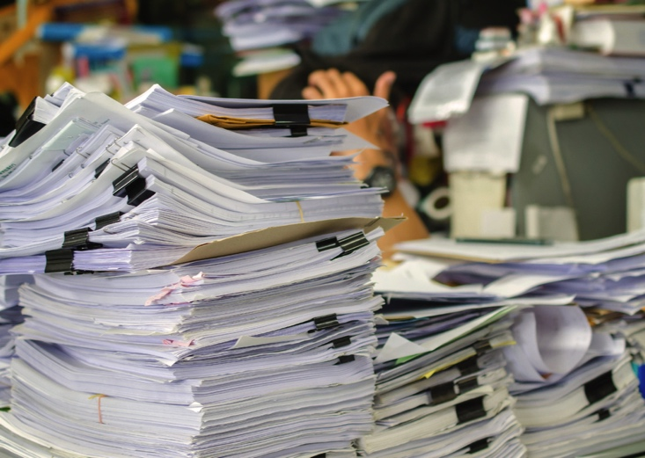
Relieving administrative burden
Electronic documents connected to
identity of products
Optimizing the data flow
Removing paper
Full history of facts added and signed

Slide 15
Adding/Wrapping services around products
Smart tagging of products
Tag – pointer to smart contract
Smart contracts invoke logic
Providing services on blockchain
Electronic guarantee

Slide 16
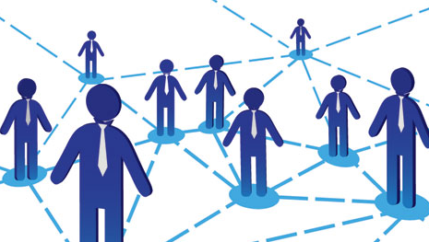
Peer-to-peer smart financing
Short-term loan for working capital
Contracts for delivery serve as pledge
Once payment is executed
the smart contract pays off the loan

Slide 17
Digital passport of equipment
Generating identity of equipment
with chips
Claiming and managing ownership
Additional services related to the
product – guarantee, new parts, etc.

Slide 18
Благодаря!
Емилиян Енев
enev@recheck.io

