Slide 1
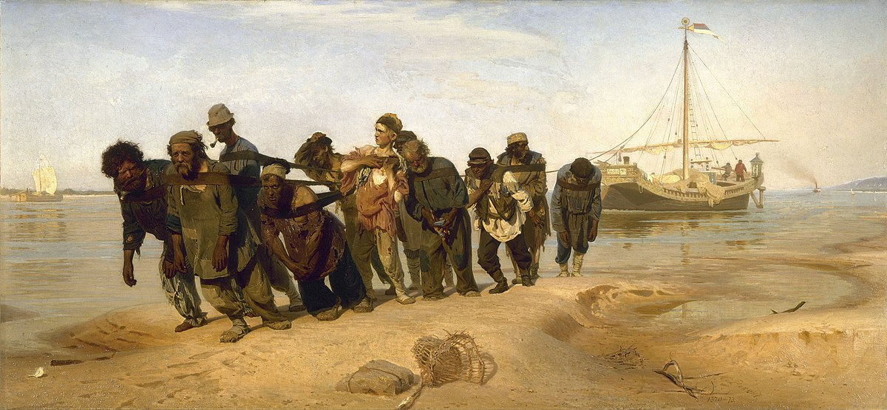
Blockchain for Business. Now.
Cloud and Blockchain Forum Bulgaria 2018
Petko Karamotchev, Director of INDUSTRIA.tech

Slide 2
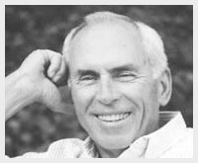
We tend to overestimate the effect of a technology in the short run and underestimate the effect in the long run.
Amara’s law
Roy Amara - American researcher, scientist, futurist and president of the Institute for the Future

Slide 3
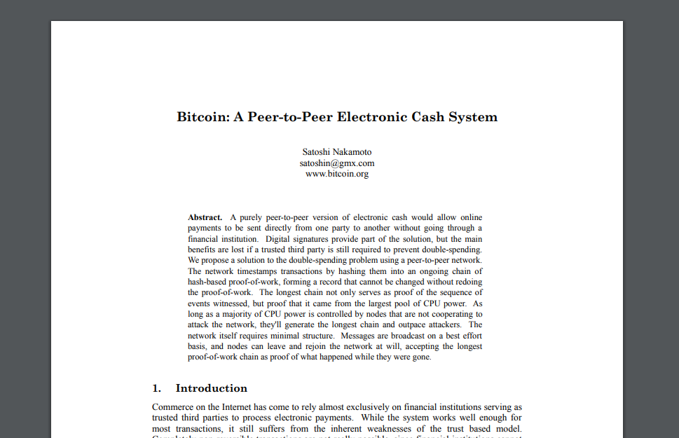
How did it started?

Slide 4
<- ANY BANK

Slide 5
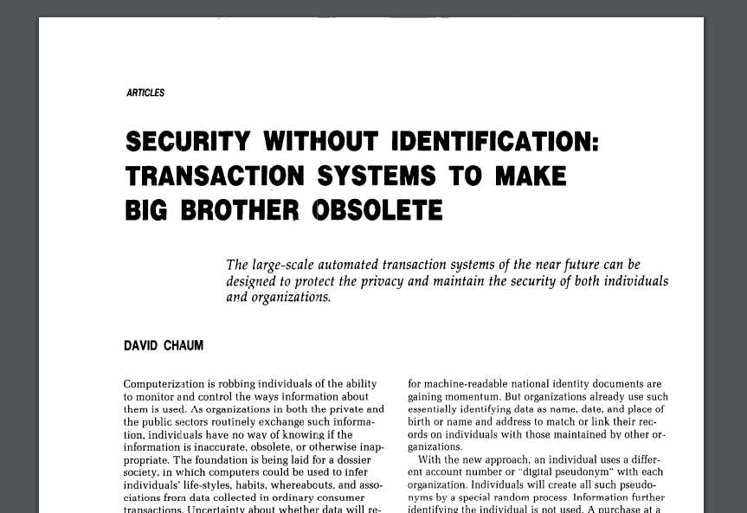
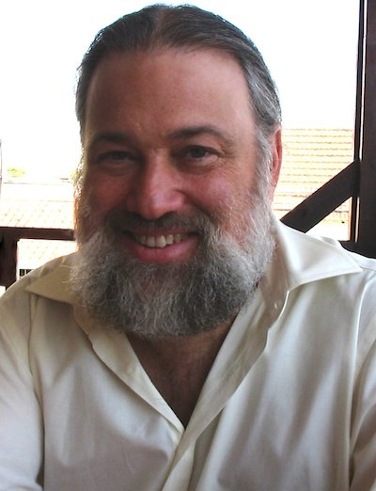
Crypto money are not a new concept!

Slide 6
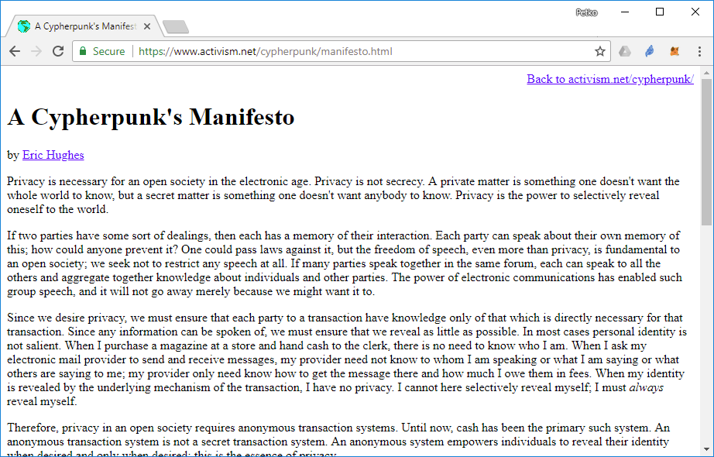
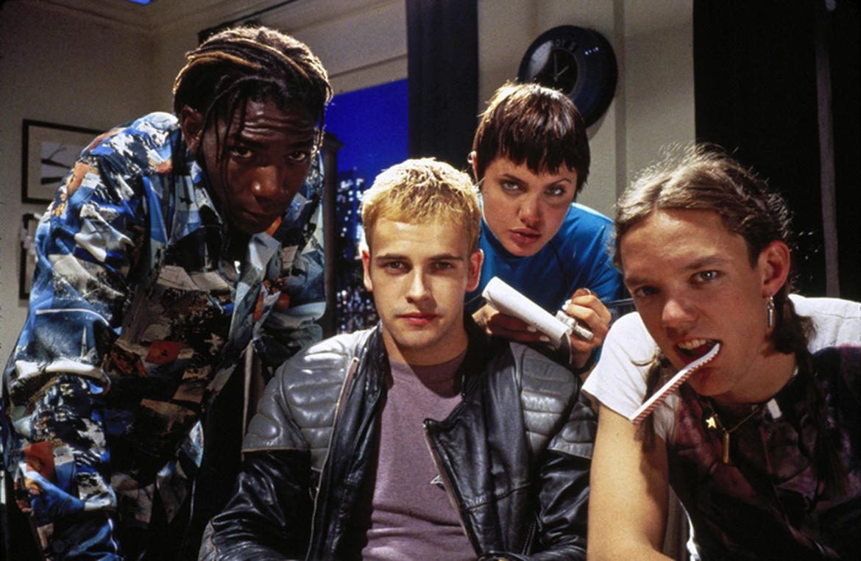
Hackers (1995) - IMDb

Slide 7
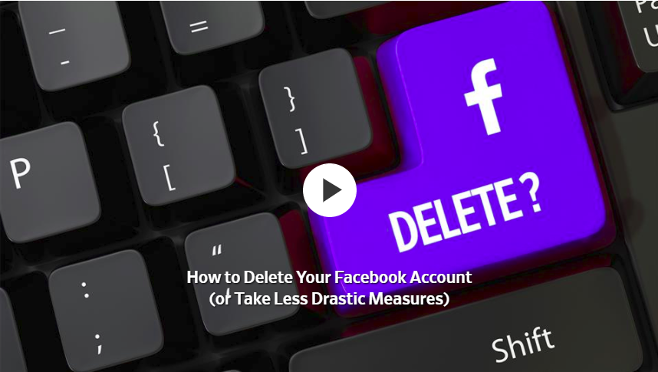

Slide 8
What is the blockchain
Many things and a lot of hype
Distributed vs decentralised
Very secure database
You can save on it different things (predominantly transactions)
Based on mathematics and many different consensus algorithms
Many blockchains (open, closed, purposed, futuristic)
Trust machine, internet of money, etc.

Slide 9
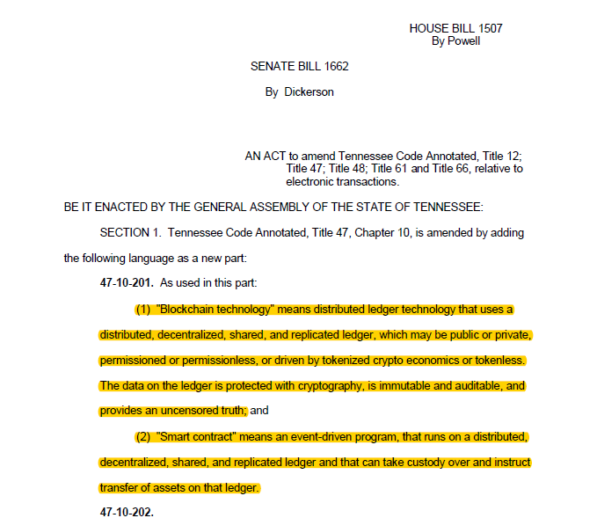
Blockchain people: - We are loving it!!!
Government : - RLY? Wait and see more of it.

Slide 10
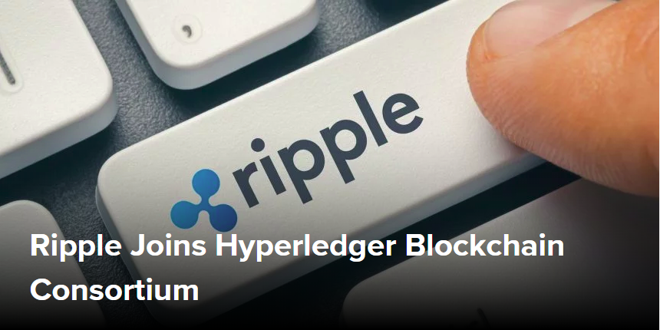
Types of blockchain
Public (Bitcoin, Ethereum, NEO, Zcash) – hard innovation
Private (Banks, Insurance companies, etc.) – soft innovation
In the meantime…

Slide 11
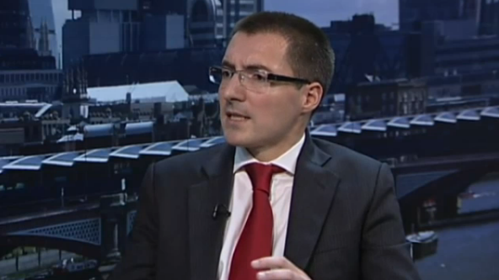
Two revolutions for the price of one
Richard Gendal Brown, Head of Technology at R3CEV

Slide 12
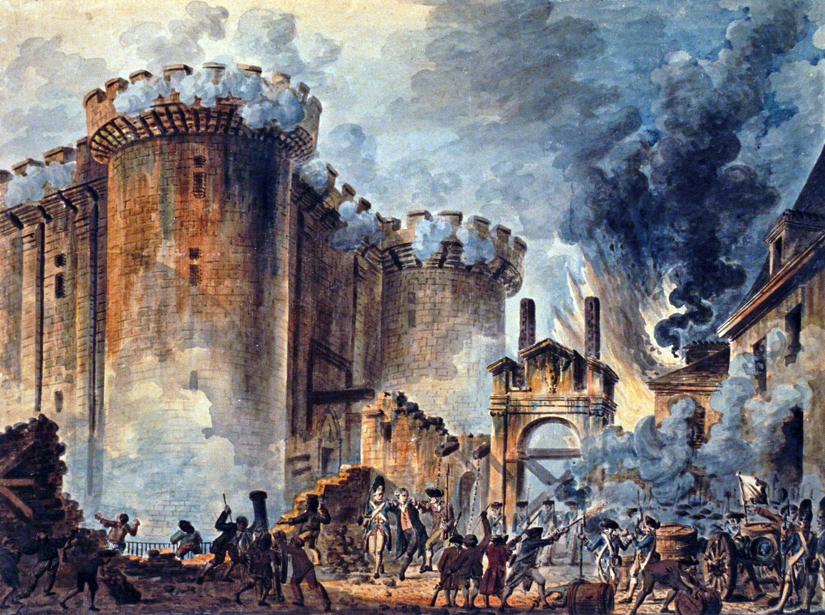
Public (Bitcoin, Ethereum, Zcash, NEO)
Hard innovation (society and technology)
Open (everyone can join)
Distributed
Global computer with no boundaries
Democratic or hmm…
Chaos and civil wars
Prints own money/has its own problems (hard forks)
Considered as dodgy in many parts of the world
Used by end clients and DAO’s

Slide 13
What excites me from the public blockchains?
Focus on decentralisation
The concept of DAO
Superiority related to the existing financial system
DAO+IOT
DAO+AI

Slide 14
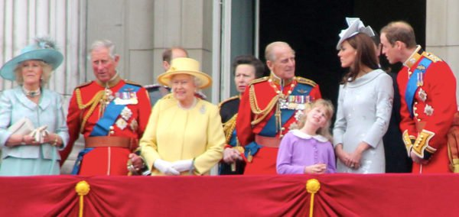
Private (Hyperledger, R3)
Soft innovation (technology and market)
Closed (participation is granted)
Method of communication between companies
Authoritative and less distributive
Strict order
Fiat money/deals with ‘real’ problems
Legal everywhere
Used by businesses, markets, regulators

Slide 15
What excites me from the private blockchain?
Inspires coopetition
Build on open source (Linux Foundation)
Transition to the future

Slide 16
Blockchain is not
(Yet) suited to high performance (millisecond) transactions
For just one participant (no business network)
A replicated database replacement
A messaging solution
Universal TPS replacement
(Yet) Suited for low value, high volume transactions

Slide 17
How to use for your new or existing business
Public blockchain
Build a Dapp
Make an ICO
Invest in crypto, ICO or infrastructure
Private blockchain
Create or participate in a market
Both
Become a developer

Slide 18
Build a Dapp
Open source
Runs on a public blockchain (Ethereum, NEO)
Decentralised
Web 3.0 (is it any good)
Might have an incentive (token)
Slow at the moment
Limited functionality
Offchain is needed
Contracts: decentralized logic
Swarm: decentralized storage
Whisper: decentralized messaging

Slide 19
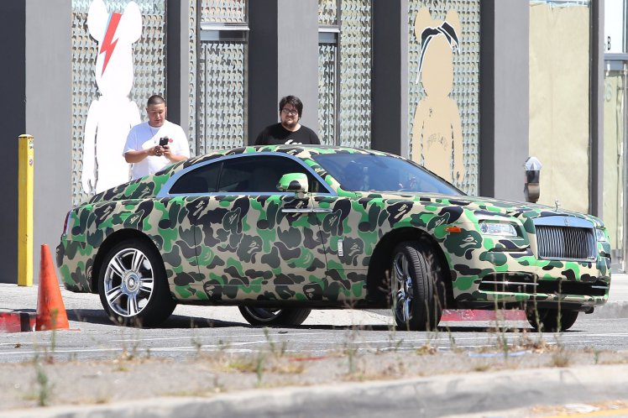
Make an ICO
Essentially a Dapp
DAO vs real company.
No point if not DAO
Eliminates the intermediary (VC, funds, etc.)
Types of tokens (payment, utility, security)
Participation is illegal in many parts of the world
46% from the 2017 ICO’s already failed. More coming soon

Slide 21
Investments in crypto tokens and ICO’s
1,400 coins and growing. Many more ICO’s. 52K SC’s on ETH!?
People may buy some crypto tokens to speculate on their values. But with such volatility, I doubt they will put their retirement savings into them.
Immature and developing space
Few meaningful but very innovative
Not many investors have the required knowledge about the technology
Became part of the infrastructure (miner, masternode)
Dogecoin has a “market value” of $1.7B, Kebab coin, Pot coin
Cryptocurrencies vs CBDC

Slide 22
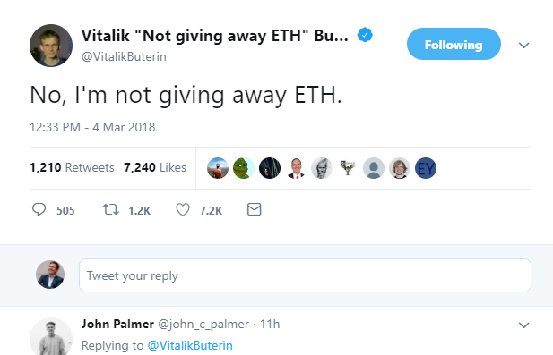
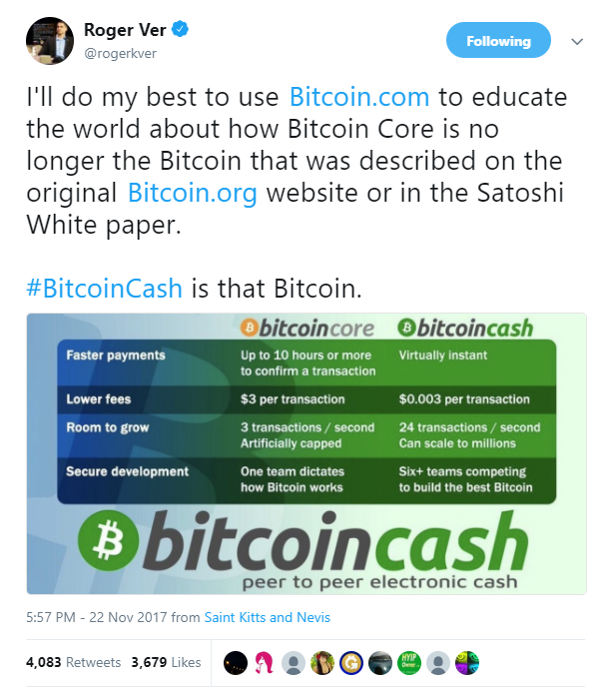
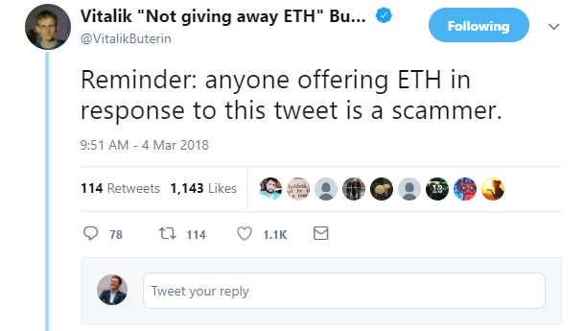
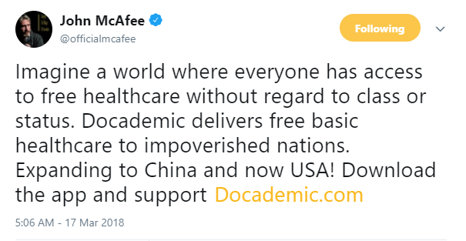

Slide 23
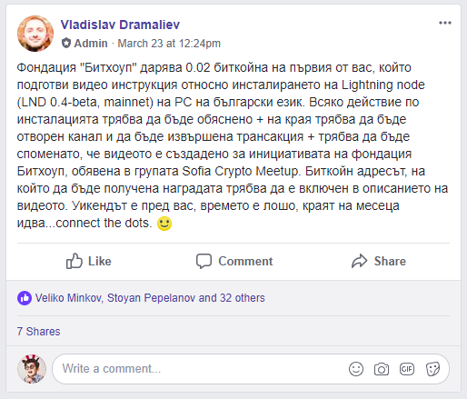
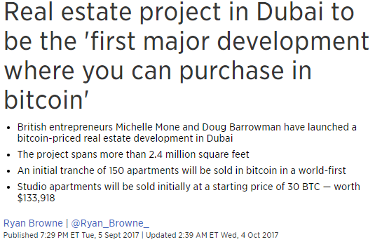

Slide 24
Create a market
Business network
Across geography and other boundaries
Save time
Reduce cost
Reduce risk
Increase trust
No cryptocurrencies

Slide 25
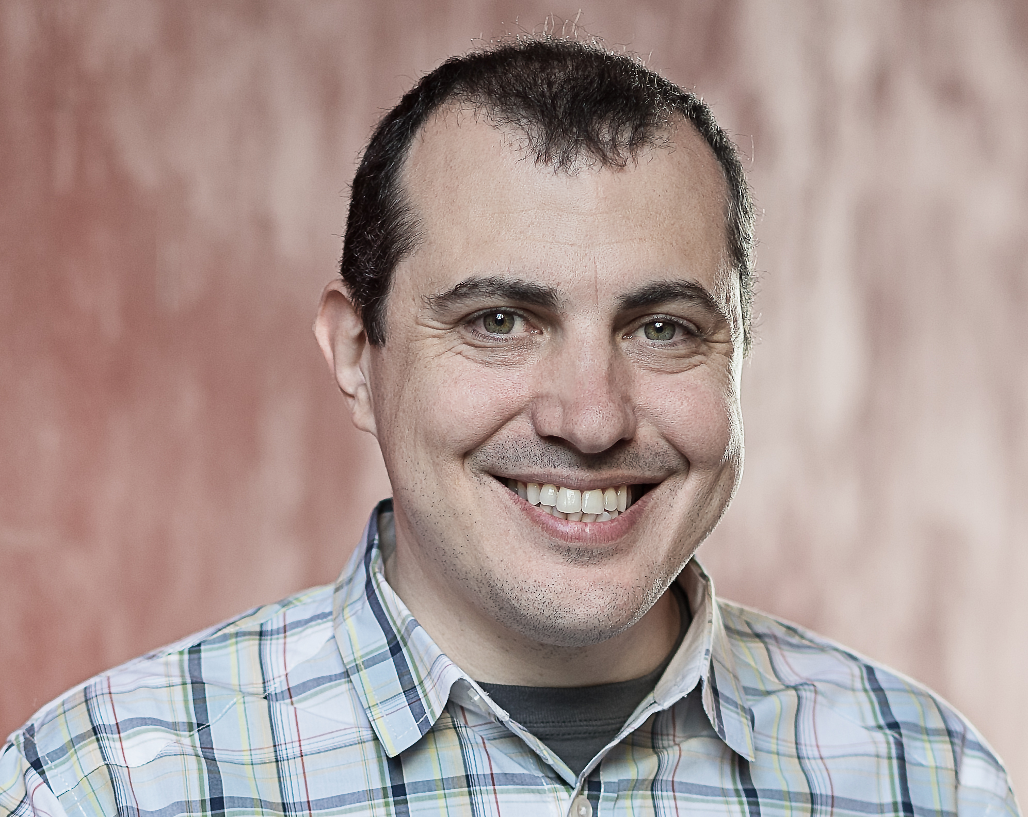
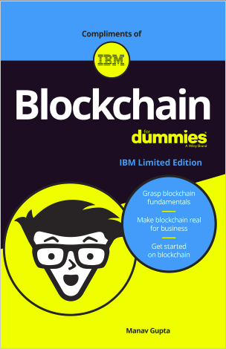
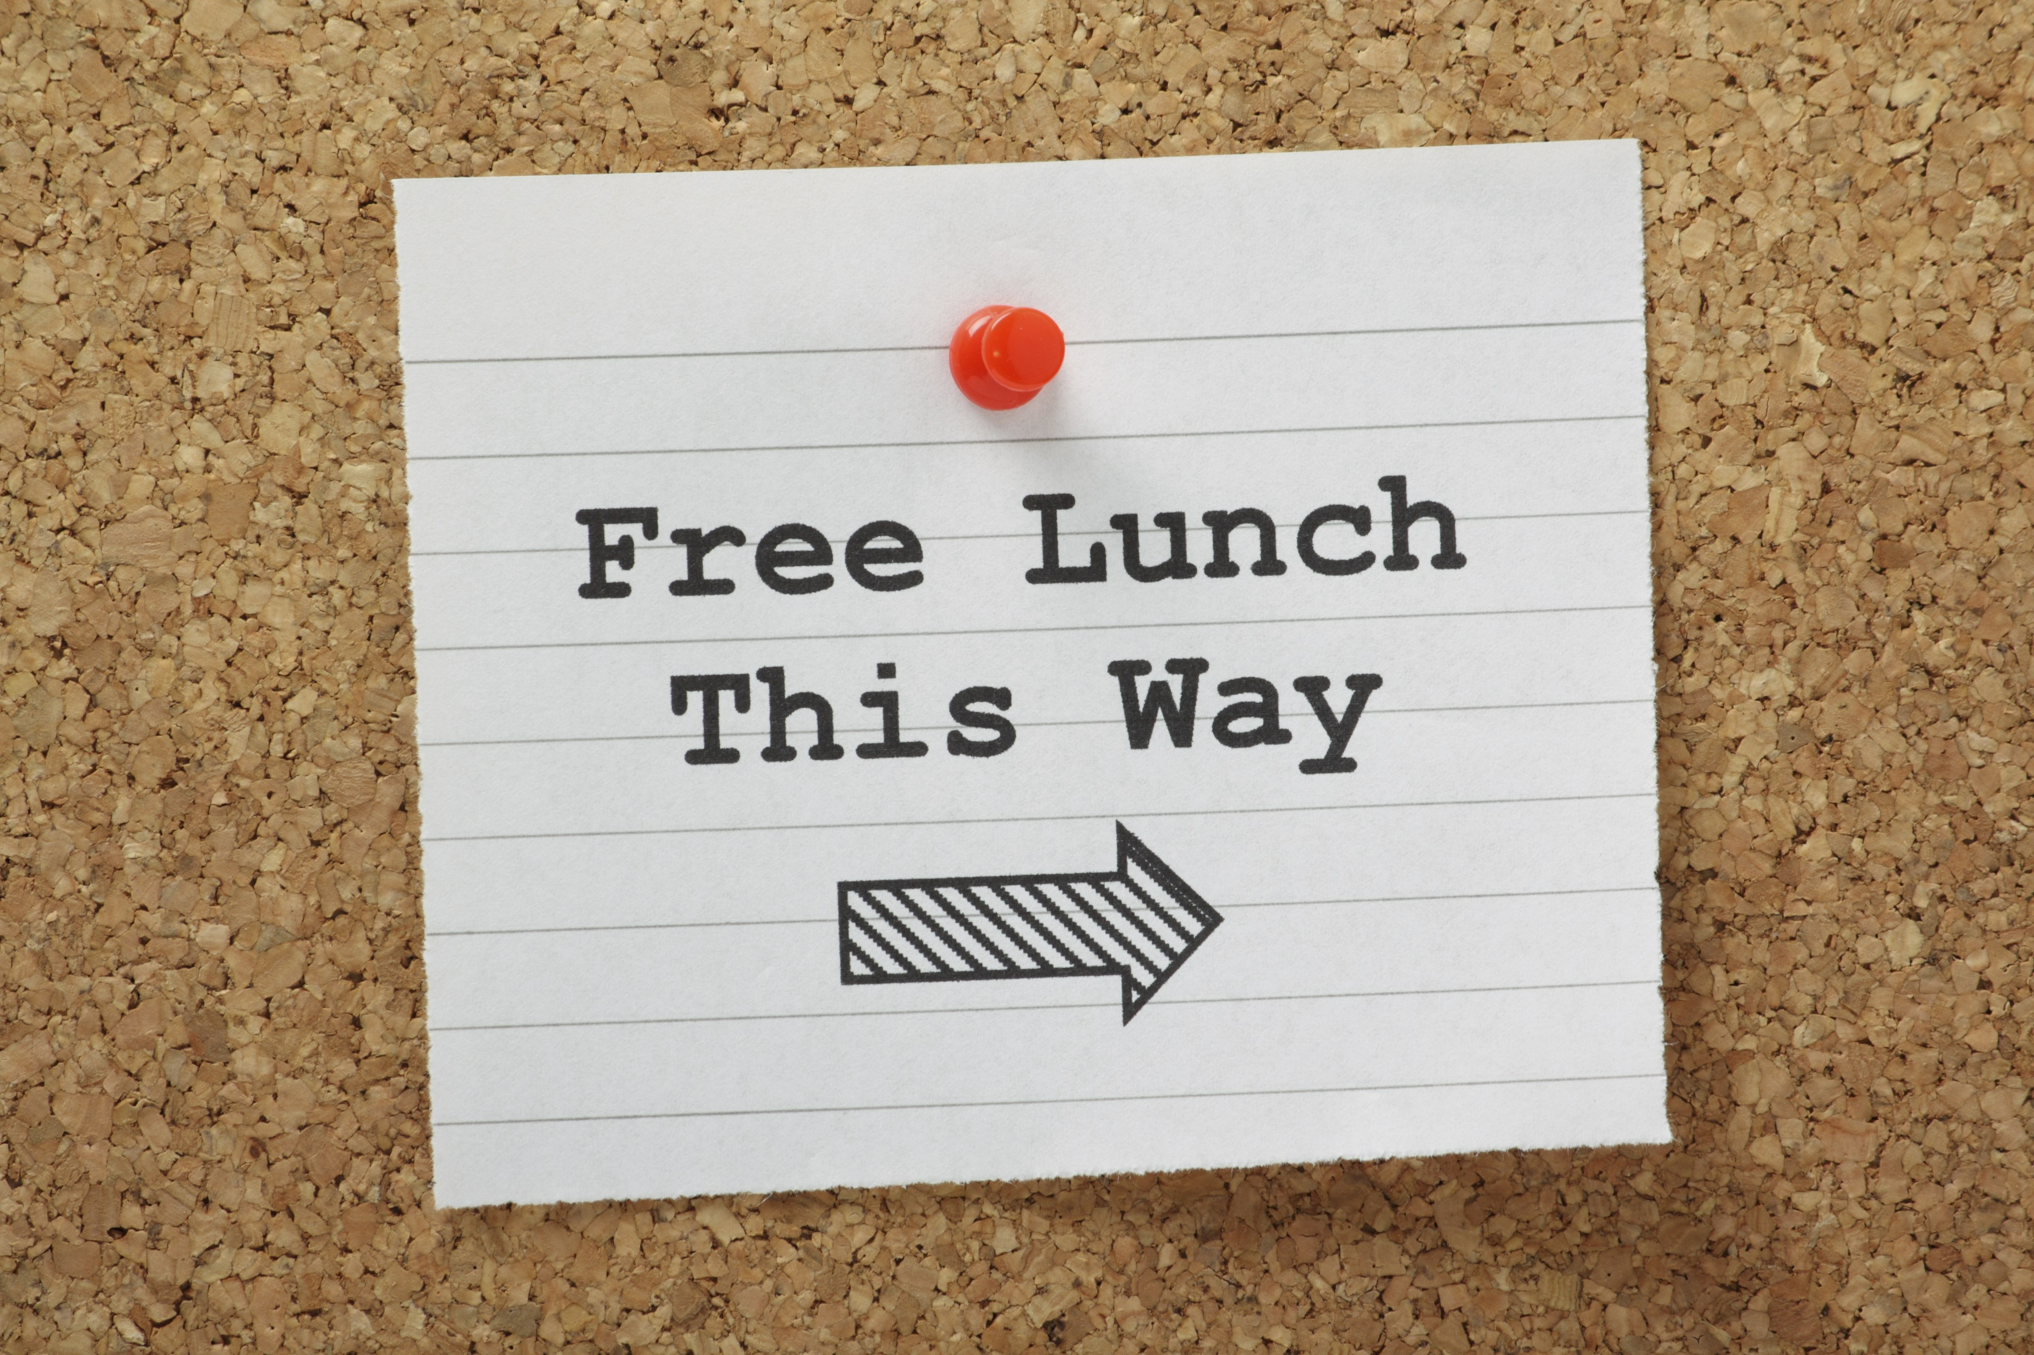
Q&A
https://blockgeeks.com/guides/
https://bitsonblocks.net/
https://www.hyperledger.org/resources/training
https://dailyfintech.com/
https://www.corda.net/
https://www.edx.org/course/blockchain-business-introduction-linuxfoundationx-lfs171x
https://www-01.ibm.com/common/ssi/cgi-bin/ssialias?htmlfid=XIM12354USEN
https://www.youtube.com/channel/UCJWCJCWOxBYSi5DhCieLOLQ

