Slide 1
Blockchain and Cryptocurrencies
Hands-On Lab: Playing with Wallets and Transactions
Ethereum
Svetlin Nakov
Inspiration Manager
Software University
http://softuni.bg

Slide 2
About Svetlin Nakov
Software engineer, trainer, entrepreneur, author of books, blockchain expert
www.nakov.com
Portfolio of 3 successful training initiatives:
National Academy for Software Development (NASD)
Telerik Software Academy
SoftUni (the Software University)

Slide 3
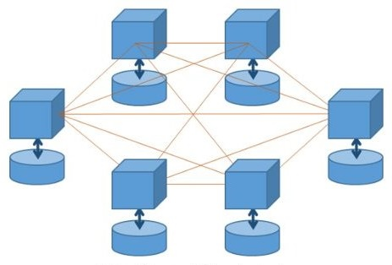
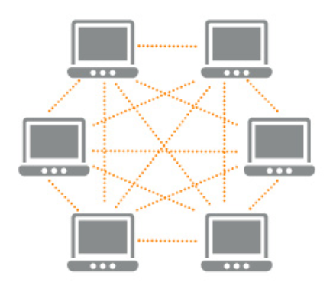
What is Blockchain?
Distributed ledger
Decentralized
(no owner)
Peer-to-Peer network
Secure
Immutable
Nodes hold ledger of facts + history of updates
Transactions are verified by the entire network

Slide 4
Blockchain == Chain of Data Blocks
Block #0 (genesis block)
Block #1
Block #3
timestamp
block_hash
timestamp
block_hash
timestamp
block_hash
prev_hash
nonce
prev_hash
nonce
prev_hash
nonce
all_transactions_hash
all_transactions_hash
all_transactions_hash
transaction #1
hash
transaction #1
hash
transaction #1
hash
transaction #2
hash
transaction #2
hash
transaction #2
hash
transaction #3
hash
transaction #3
hash
transaction #3
hash
…
…
…
Demo: https://etherscan.io

Slide 5
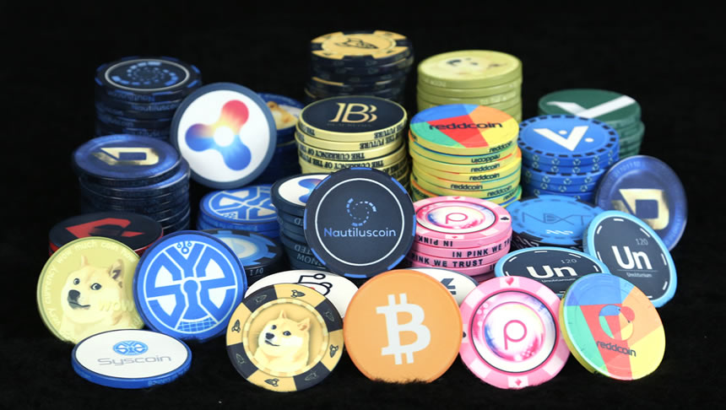
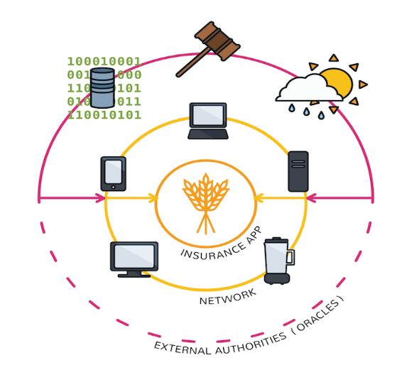
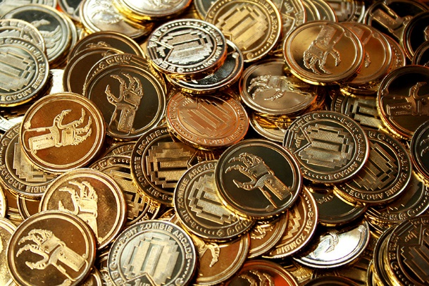
Blockchain Applications
Decentralized applications
Cryptocurrencies
Digital investments
Digital money with no central bank
Fund raising / ICO / token sales
Removing the middlemen

Slide 6
Blockchain Platforms
Bitcoin
Ethereum
Litecoin
Ripple
Dash
The first famous blockchain cryptocurrency
The first famous smart contracts platform
Monero
https://coinmarketcap.com

Slide 7
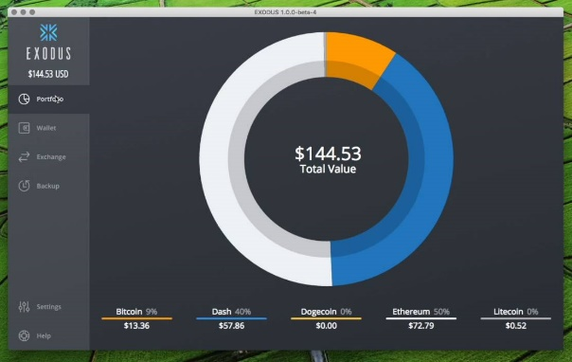
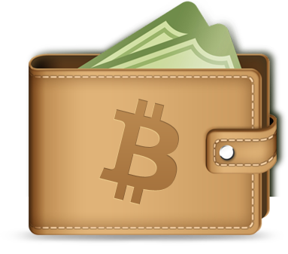
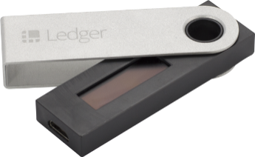
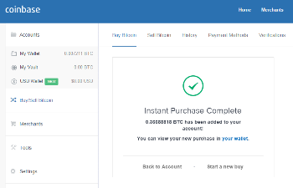
Wallets
Cryptocurrency wallets:
Store securely the private keys of your blockchain assets
Software wallets
Hold multiple addresses + private keys
May hold BTC, ETH, ERC20 tokens, etc.
Hardware wallets
Online wallets

Slide 8
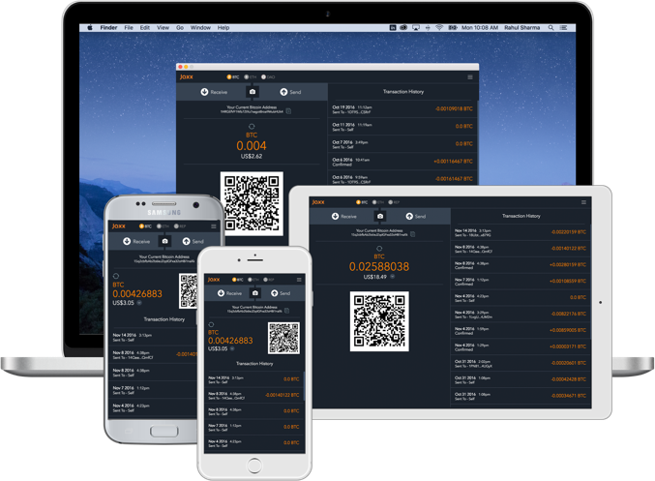
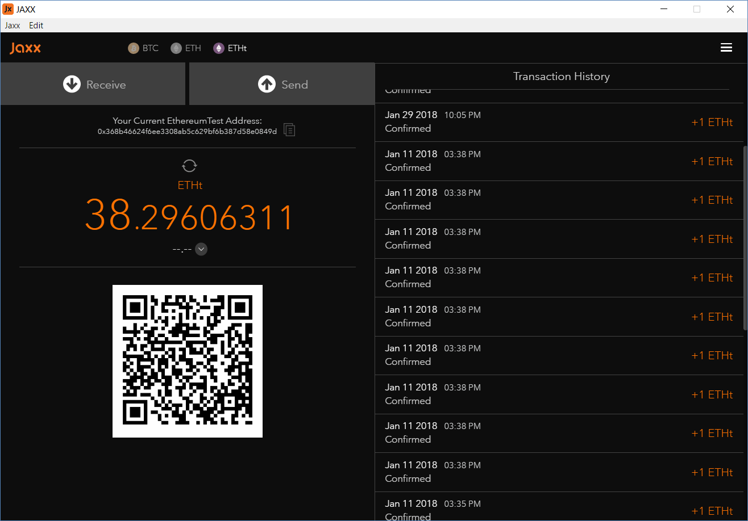
Practice
Play with Jaxx Wallet and Ethereum

Slide 9
Install the Jaxx Wallet
Jaxx Wallet
Desktop / Mobile
https://jaxx.io

Slide 10
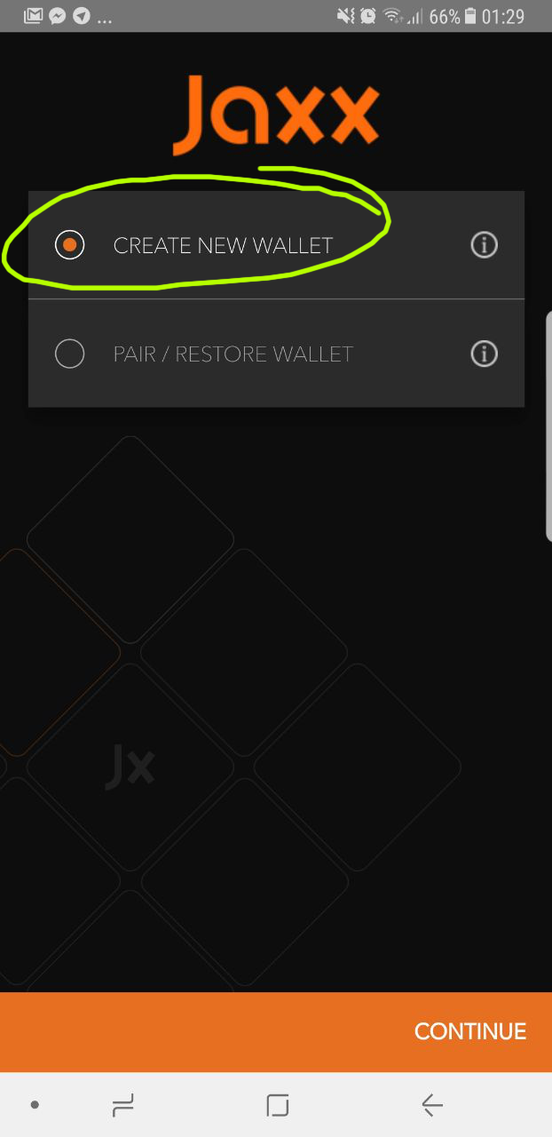
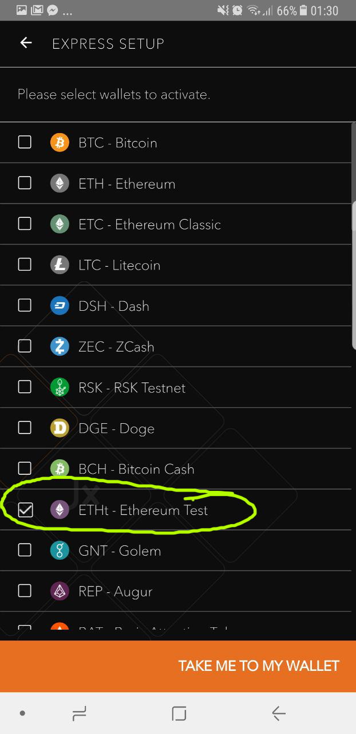
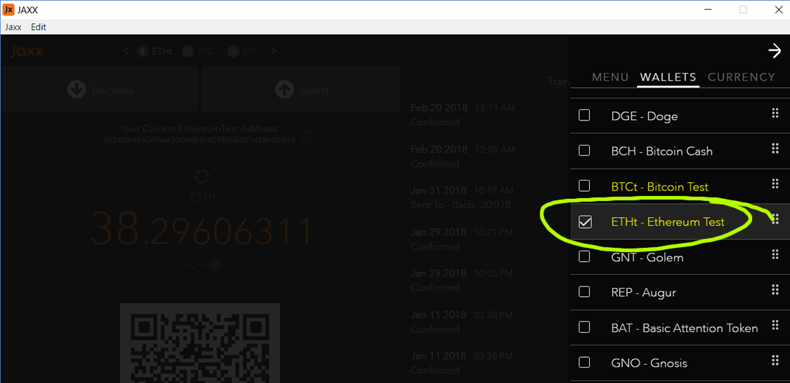
Enable the Ethereum Testnet (ETHt)

Slide 11
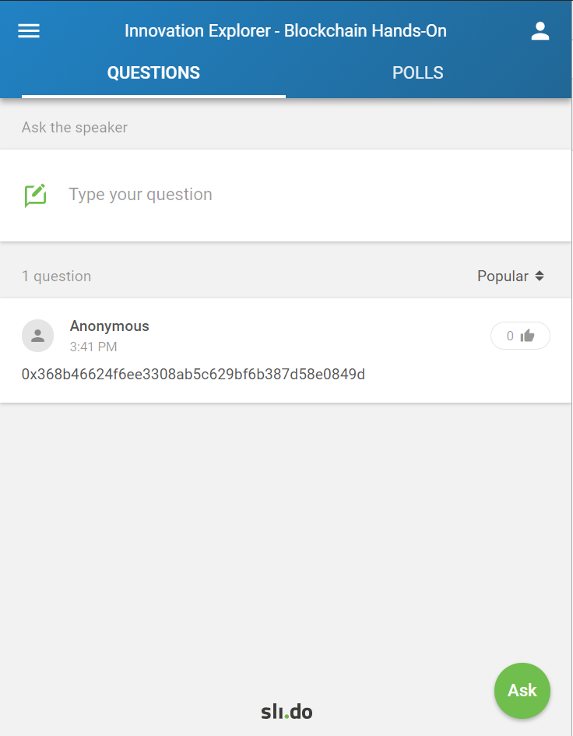
Share Your Wallet Address with Us
http://sli.do
#jaxx

Slide 12
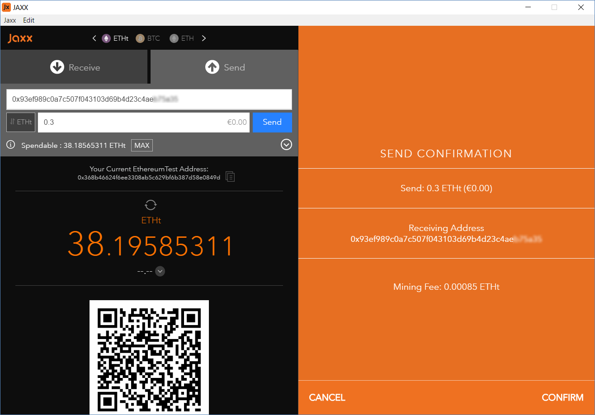
Send ETHt to the People Around You
Send ETHt to the People Around You

Slide 13
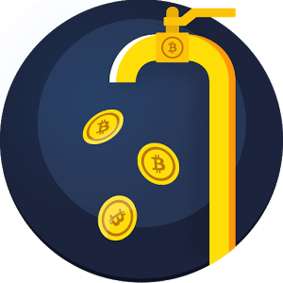
Ethereum Testnet Faucets
Request test ethers (ETHt) from the Faucets
http://faucet.ropsten.be:3001
https://faucet.bitfwd.xyz
http://tiny.cc/ropsten-faucet

Slide 14
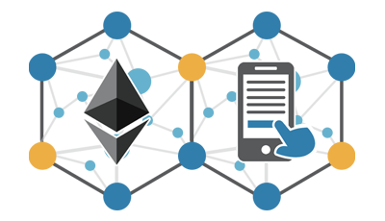
Blockchain and Cryptocurrencies

Slide 15
License
This course (slides, examples, demos, videos, homework, etc.) is licensed under the "Creative Commons Attribution-NonCommercial-ShareAlike 4.0 International" license

Slide 16
Trainings @ Software University (SoftUni)
Software University – High-Quality Education, Profession and Job for Software Developers
softuni.bg
Software University Foundation
http://softuni.foundation/
Software University @ Facebook
facebook.com/SoftwareUniversity
Software University Forums
forum.softuni.bg

