Slide 1
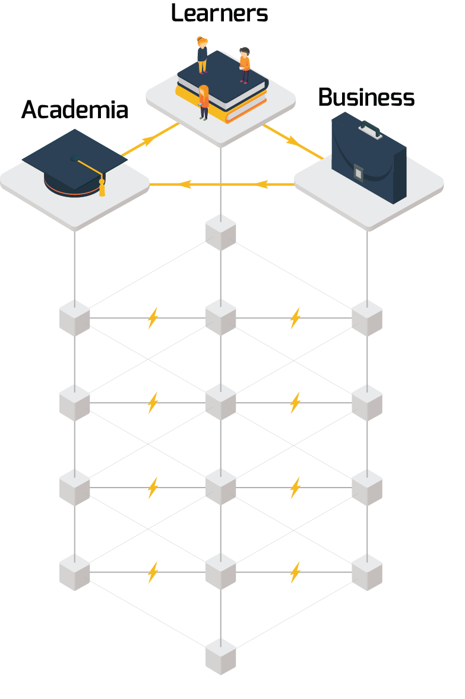
BLOCKCHAIN BEYOND CRYPTOCURRENCIES: APPLICATION IN THE FIELD OF LEARNING & DEVELOPMENT
March 30th 2018, Cloud & Blockchain Forum Bulgaria

Slide 2
Doctoral Candidate at TU Sofia, Open Source Project Management.
Policy Expert at Brain Workshop Institute.
Former Advisor to the Ministry of Economy, R&D Specialization Strategy.
Former Member of the Expert Group on the Development of OPNOIR 2014-2020.
Former Strategy & Transformation Expert at Hewlett Packard Enterprise.
Hristian Daskalov
Project Lead

Slide 5
WHAT ARE WE WORKING ON?

Slide 6
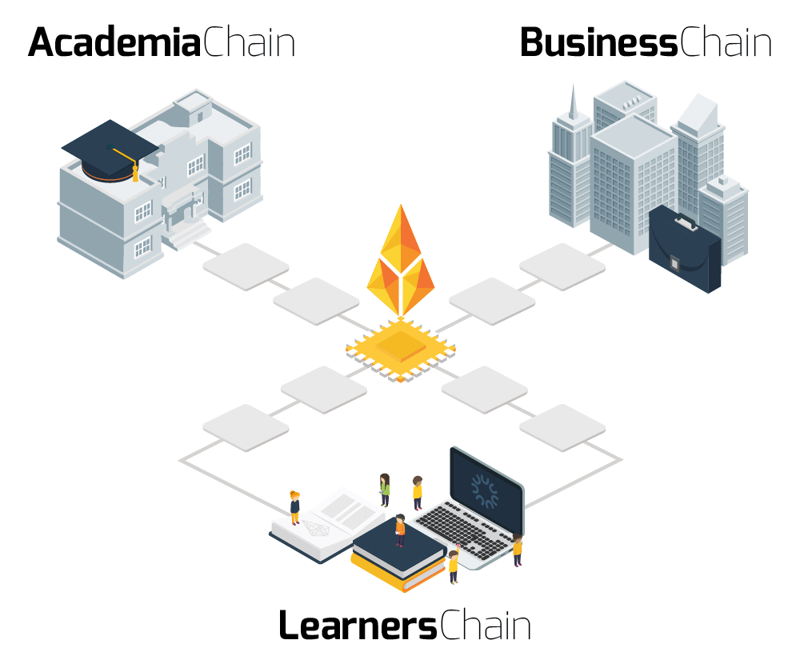
The Open Source University project is about innovating in Academia though open source technologies and collaboration.
Supported by the European Commission, recognized by EY, AIESEC, HPE’s “Living Progress Challenge”, Ministry of Education.
In partnership with higher education institutions, corporate and NGO partners globally.

Slide 7
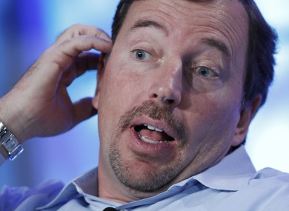
STATUS QUO
Half of workers encountered lies in colleagues’ resumes. 1/3rd of applicants removed due to false information.
30+ days spent per candidate on reviewing claims around experience, education, skills.
Millions spent by higher education institutions on verifying alumni credentials.
New York
Sofia

Slide 8
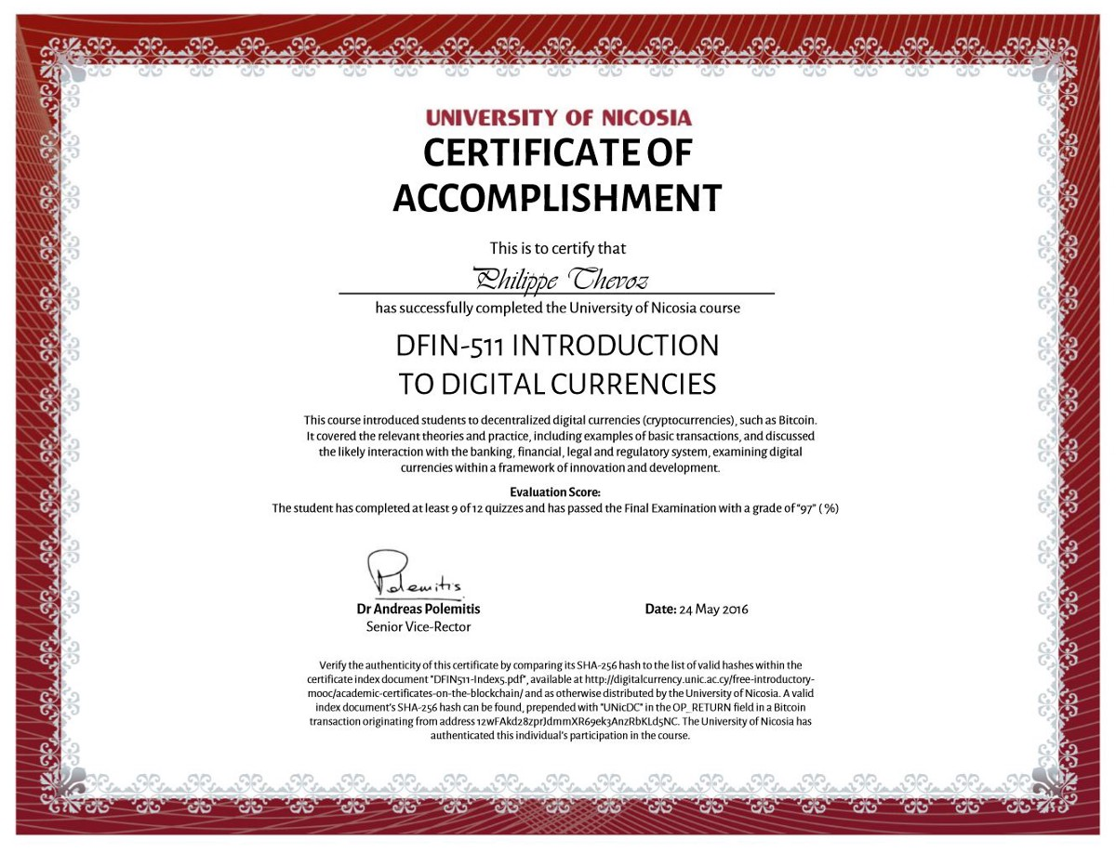
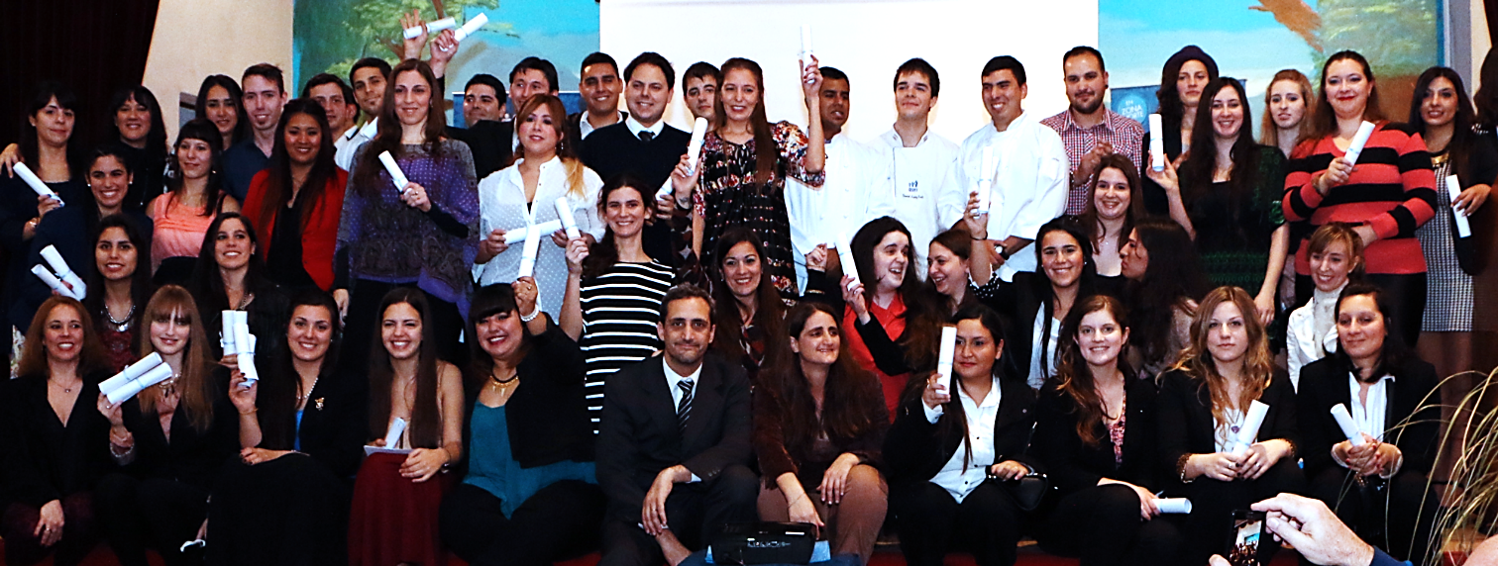
WHY BLOCKCHAIN?
Authenticity;
Decentralizing Trust;
Less Bureaucracy;
Direct interaction;
Security.
Cyprus’ pilot
Argentina pilot
Notes:
2015 Argentina graduates with proof of their diplomas on Bitcoin’s blockchain, thanks to a piloting project by ‘Signatura’ and Calidad en Educación en Zona Norte College. Source: https://blog.signatura.co/first-official-career-diplomas-on-bitcoin-s-blockchain-69311acb544d.

Slide 9
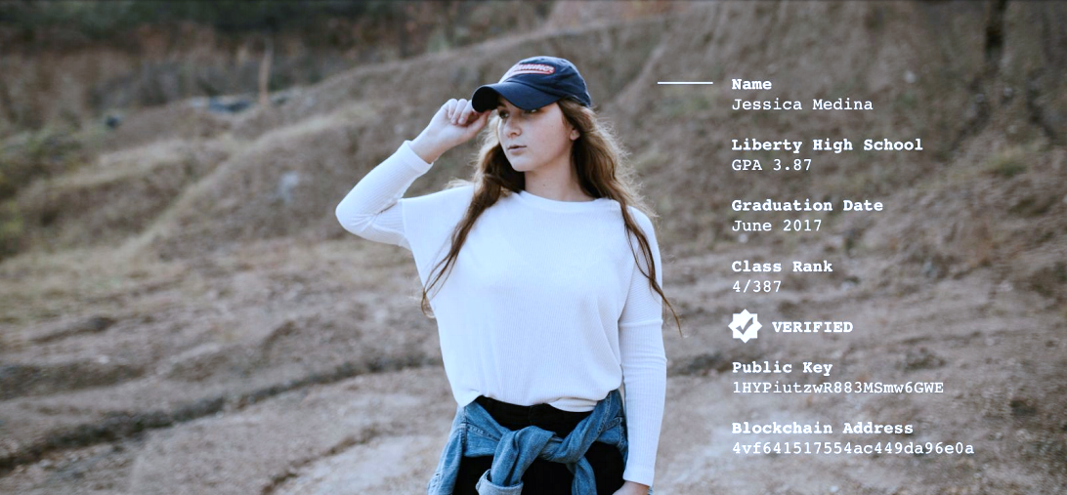
Self-Sovereign Educational and Professional Identity on the Blockchain
Photo credits: Learning Machine

Slide 10
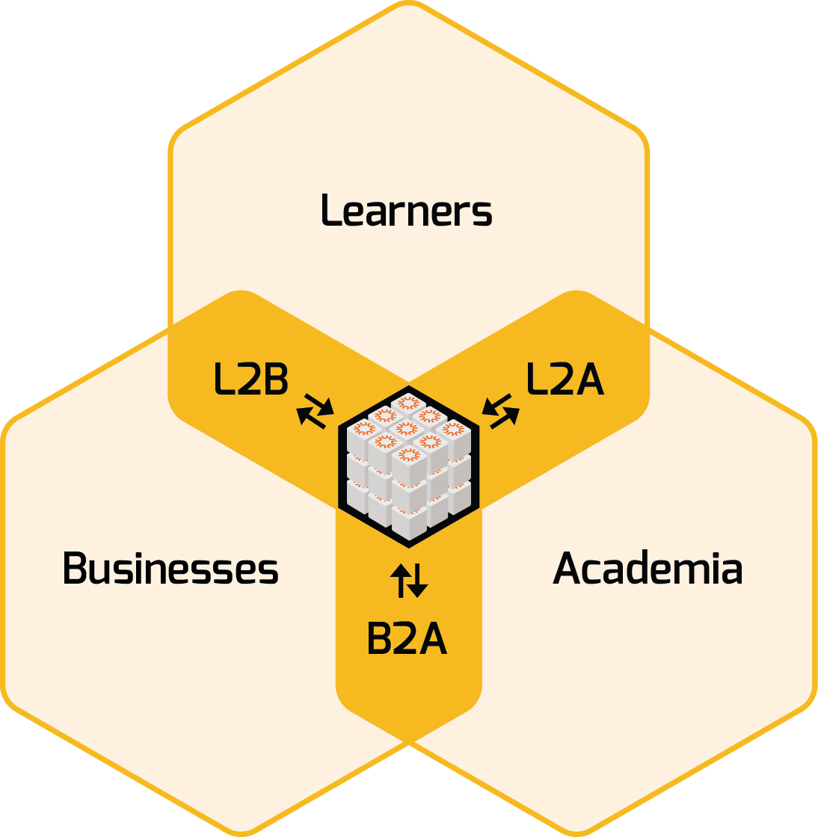
Single institution use case - authentication of certificates I Groups of institutions - shared repositories of accomplishments and shared business models I National database - state-regulated qualifications I International database – credits’ transfer I Global assessment I Reliable open badges, MOOCs achievements I Smarter Hiring I Continuing Professional Development – currently poorly tracked, not mobile, not incentivized I …

Slide 11
LEARNERS
Blockchain verified credentials, showcased worldwide;
Educational opportunities, distributed learning pathways;
Matching the right employment opportunities.

Slide 12
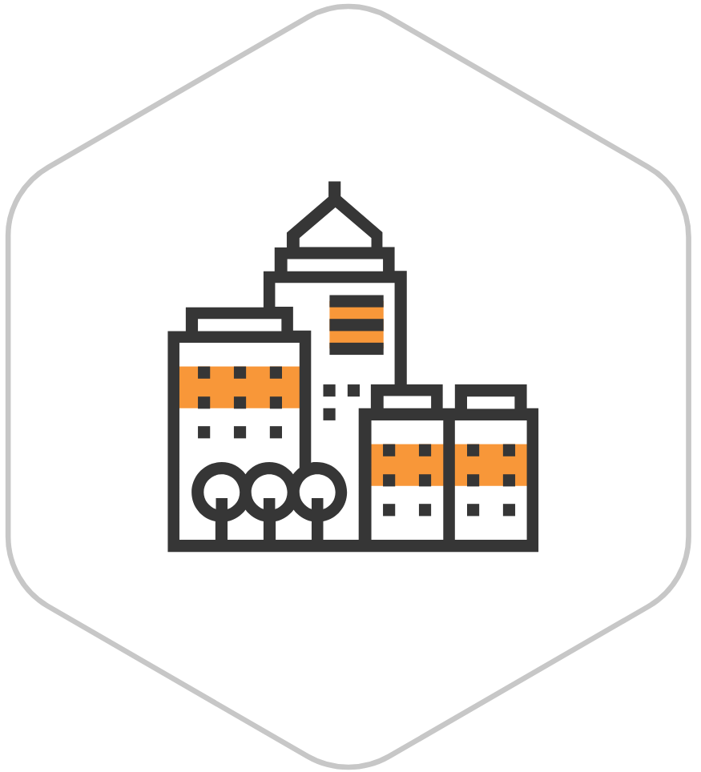
BUSINESSES
Access to global of pool of talent, verified by blockchain;
Traceability of achievements;
Reduced recruitment costs.

Slide 13
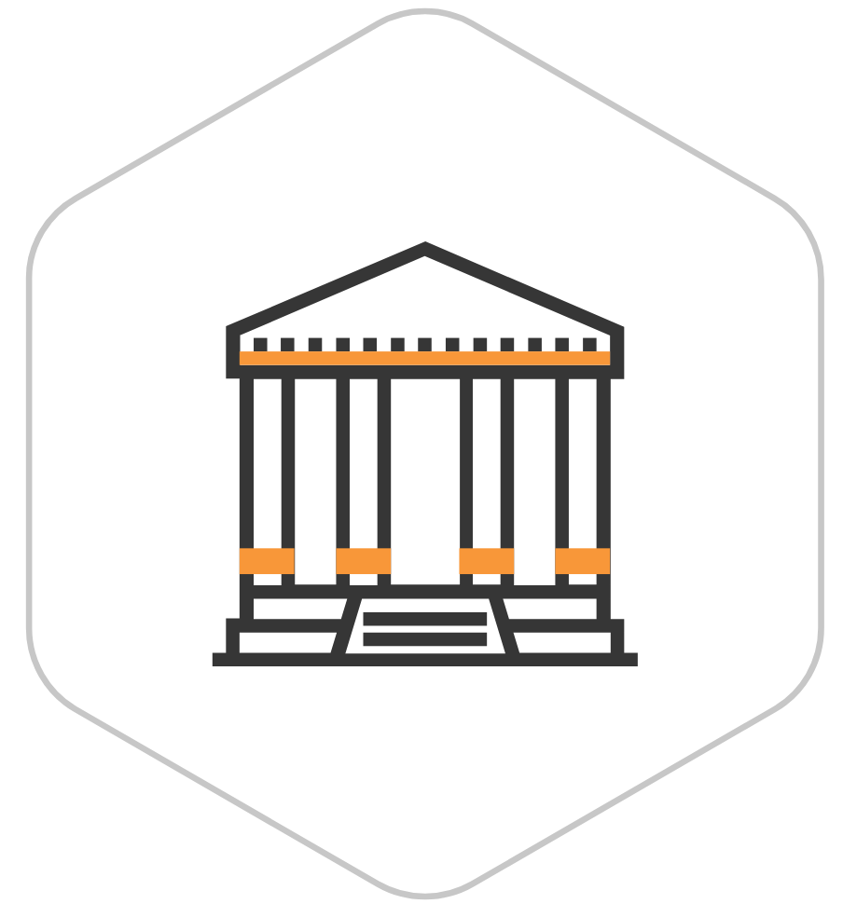
ACADEMIA
Transparent and cost-effective credentialing model;
Exposure to the global market in a scalable way;
Collaboration opportunities with businesses.

Slide 14
“We envision a world in which the awarding and validation of qualifications no longer occur exclusively under the management of an education institution or an employer and individual students, teachers, and peers take more ownership of the learning experience and its outcomes (...)"
Prof. John Domingue, Director of Open University’s Knowledge Media Institute

Slide 15
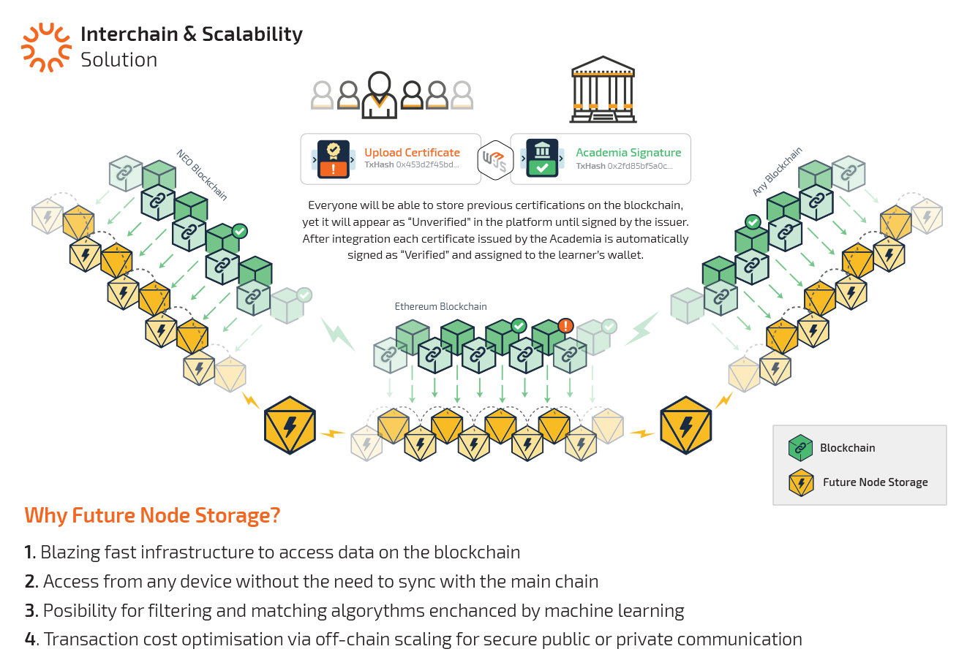

Slide 16
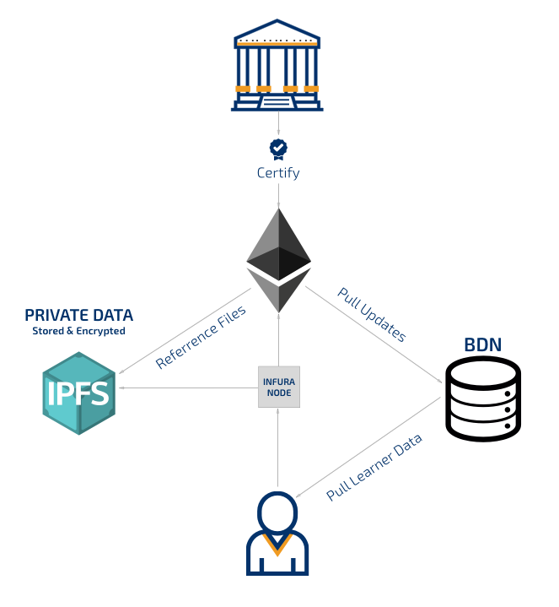

Slide 17
WHAT’S NEXT FOR US?

Slide 18
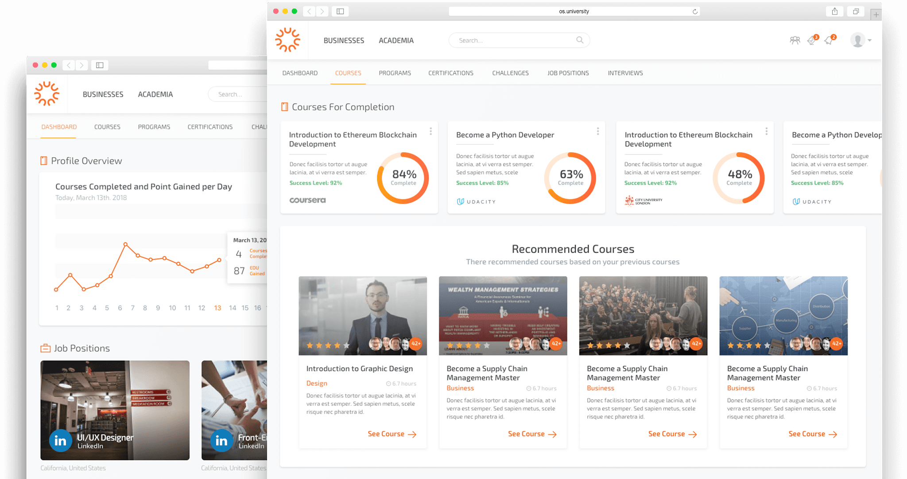
Alfa-Release: Q2 2018;
Knowledge Sharing:
“Academia 4.0. – University on the Blockchain”;
“Crypto Economy & Blockchain Technology”;
Research & Consultancy:
Center for Open Science and Business Development.

Slide 19
WHAT’S NEXT FOR YOU?

Slide 20
You probably don’t need a blockchain.
Source: Blockchain Capital LLC
N
Y
N
N
Can you articulate a real business problem that needs solving?
Could it have it been fixed before blockchains?
Do you need a database?
Do many people need to write to it?
Are writers known and trusted?
Are writers’ interests unified?
Y
N
Y
Y
Y
Y
N
N
You most probably need a public blockchain!
Do you value censorship resistance and immutability over efficiency?
Do you want to rely on a trusted third party?
N
Y
Y
Coordinate those entities into a consortium.
Is consensus determined by multiple entities?
Y
N
N
Do you need to control read and write access?
Will all participants need to upgrade and replace systems?
N
Y
You might need a blockchain...
N
Choose the best blockchain or DLT [hybrid]
You might need a private distributed ledger.
Y
However, another DLT solution might be better, let’s see.
Do the benefits justify the cost of the adoption?
Y
N

Slide 21
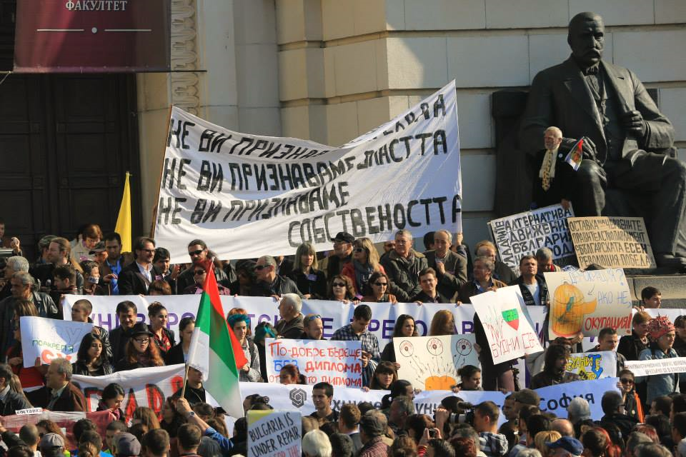
‘Internet of Things’ era is about collecting, connecting, and making sense of data. We need a ‘Diploma of things’ mechanism to collect, connect and make sense of learning. Therefore the distributed education and career development ledger is what we work on at www.OS.UNIVERSITY.

Slide 22
WHAT’S NEXT FOR THE WORLD?

Slide 23
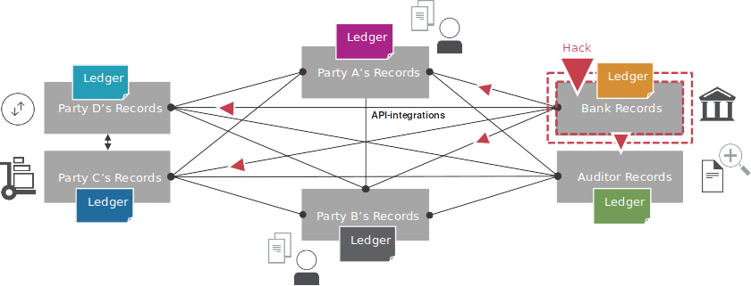
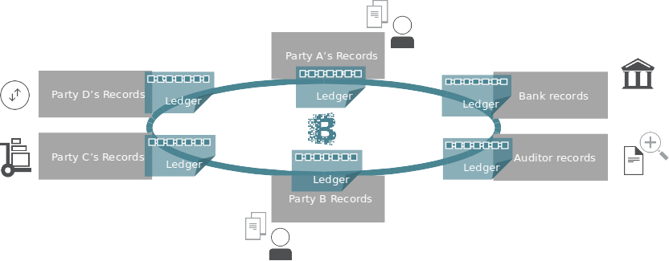

Slide 24
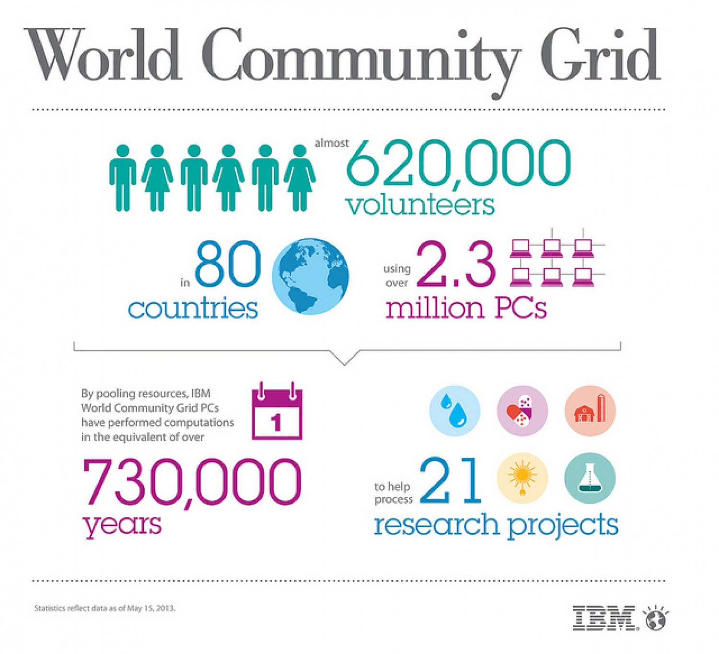
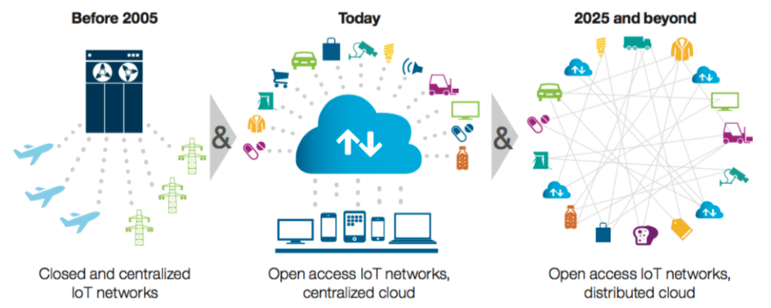
IBM’s Device Democracy
e.g. World Community Grid
Connectivity Democracy
The Internet of Things means Ledgers of Things;
Sharing Economy 2.0 – Uber without the Uber.

Slide 25
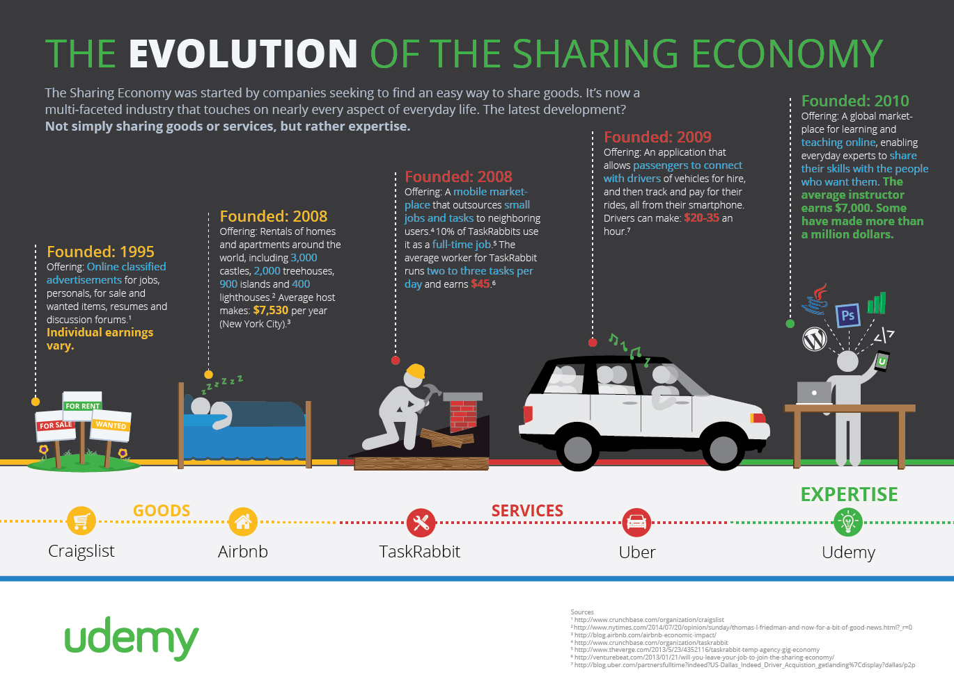

Slide 26
Conclusions:
There’s a broader transformation undergoing, i.e. from “Internet of Things” to “Internet of People”;
Blockchain is simply an incremental innovation. PKI & encryption + consensus mechanisms;
Broader adoption in public & corporate governance is expected. Because move is from “Open Source Software” to “Open Source Economy”.
Notes:
First problems was consesnus about value. Consesnsus of value is not hard, hard is consensus about distribution of value. Now they say, problem is no underlying asset. E.g. Royal Mint

Slide 27
The future is already here —
it's just not very evenly distributed.
William Gibson, cyberpunk writer

Slide 28
THANK YOU!
www.linkedin.com/in/hristian

