Slide 1
Making people smile is the ultimate goal of our software solutions.
We do IT for you.

Slide 2
THINGS WE KNOW ABOUT THE WORLD
Left and right brain hemispheres are responsible for different talents
The sun is a yellow star
Dogs don’t sweat
Einstein failed math
The tongue has different receptors in separate parts for distinct tastes
The moon comes out at night
We have 5 senses
What goes up must come down
We only use 10% of our brains
Goldfish have 3-second memory span
Alcohol keeps you warm
Ninjas wore black

Slide 3
BLOCKCHAIN PROMISES
It will save independent journalism - civil.co
It will topple the establishment – dav.network
It protects personal data - enigma.co
It will make charity transparent - alice.si
Brings banking to everyone - ethichub.com
It will increase energy efficiency - powerledger.io
Helps the vulnerable – Syrian refugees in Jordan
Preserves the wild life - earthbankofcodes.org
Helps us save democracy - votewatcher.com
Combats climate change - climatechaincoalition.io
It will create a decentralized internet
It will make banks defunct – bitcoin.org

Slide 4
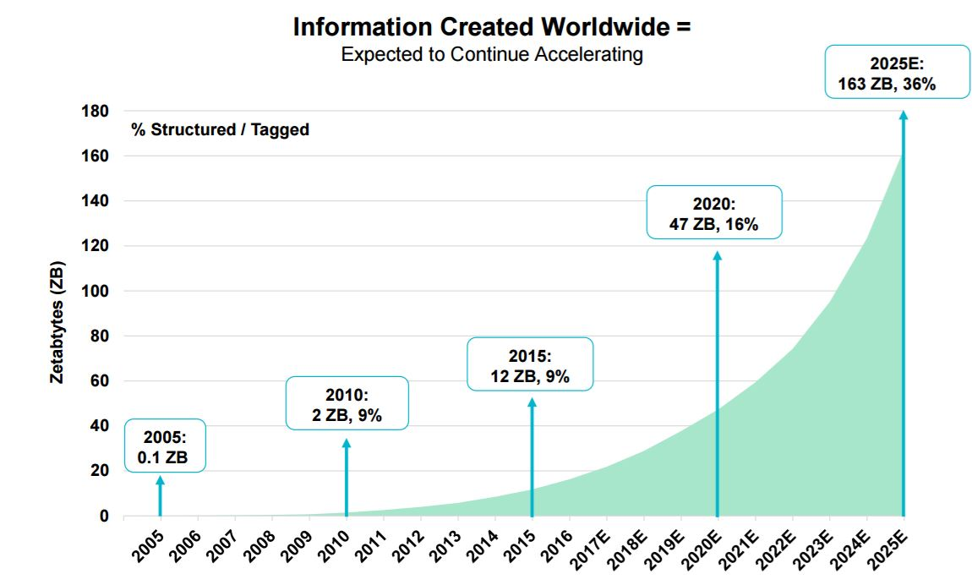
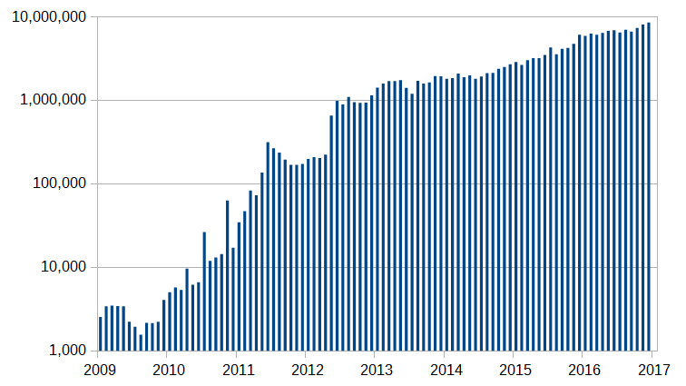
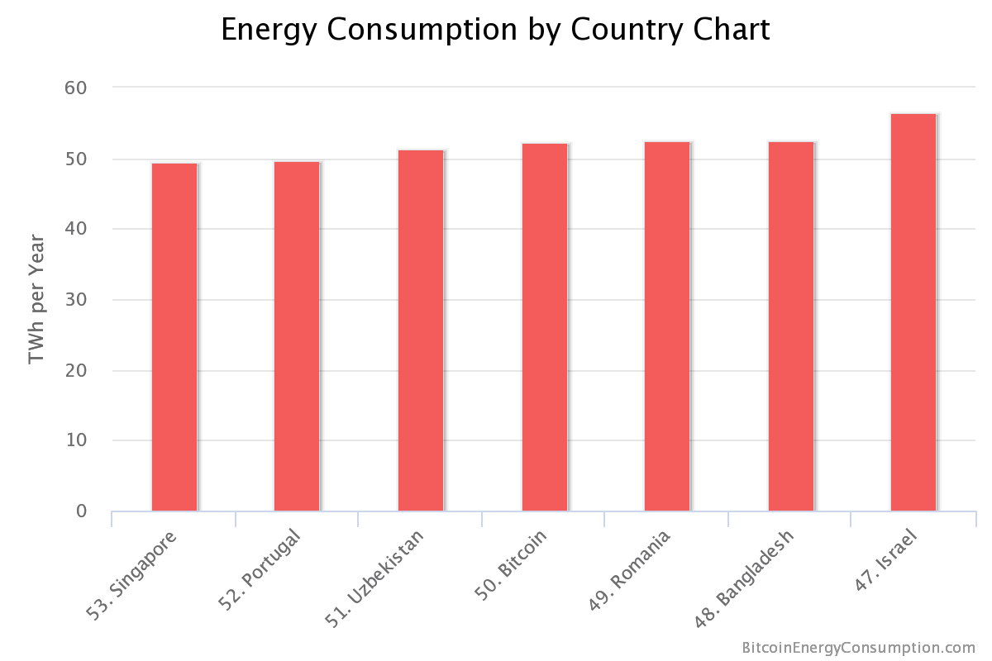
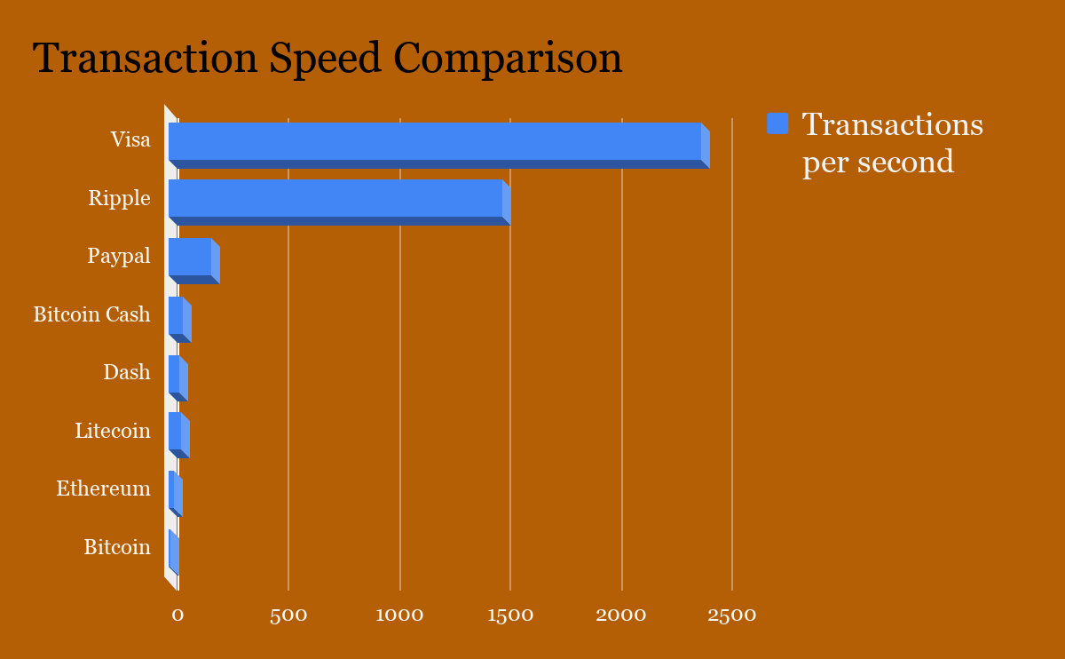
VISUALIZING THE STATE OF AFFAIRS

Slide 5
CHALLENGES
The bubble
Scalability
Known weaknesses
Hard forks
Centralization
The CAP theorem
Timejacking
DoS
Wallet theft
Packet sniffing
Sybil attacks
Energy consumption
Smart contracts
Storage constraints
Lack of tooling
Limiting information access
Knowledge threshold for using all the benefits

