Slide 1
Adopting the cloud
Scalable websites without servers
Konstantin Halachev
Cloud forum Bulgaria 2017, 30 March

Slide 3
About me
Now: Team lead for chat bots development, senior data scientist and engineering ambassador @ Skyscanner
Before: PhD in Computational Biology from Max Planck Institute, Germany
Always: data and hacking enthusiast

Slide 4
How about this?

Slide 5
Idea
Get the best flight deals
to attend concert of favorite band or
games of favorite teams

Slide 7
What do we need?

Slide 8
Get schedules of events
Get prices for flights
Make a (decent) website
What do we need?

Slide 9
Get schedules of events
Get prices for flights
Make a (decent) website
What do we need?

Slide 11
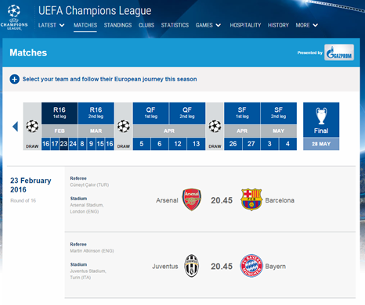
Talk to marketing guys

Slide 13
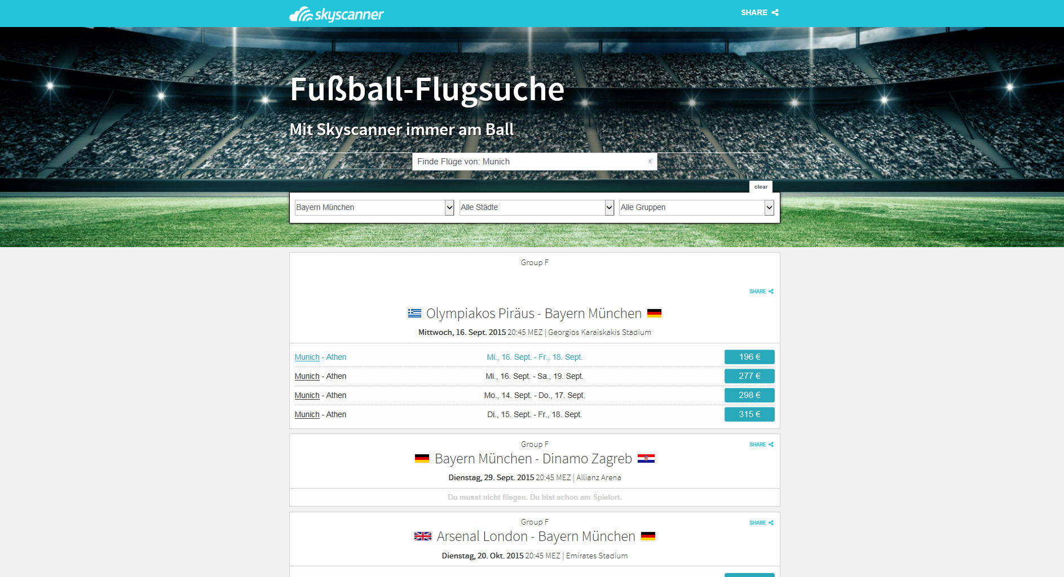
Some development later ...

Slide 14
How do we run this in production?

Slide 15
Where to get the machines?
How to handle dynamic load?
How to spread load equally over machines?
How to ensure security?
How to deploy changes?
How to monitor metrics?
etccccc
How do we run this in production?

Slide 18
AWS has it all! (for $)

Slide 19
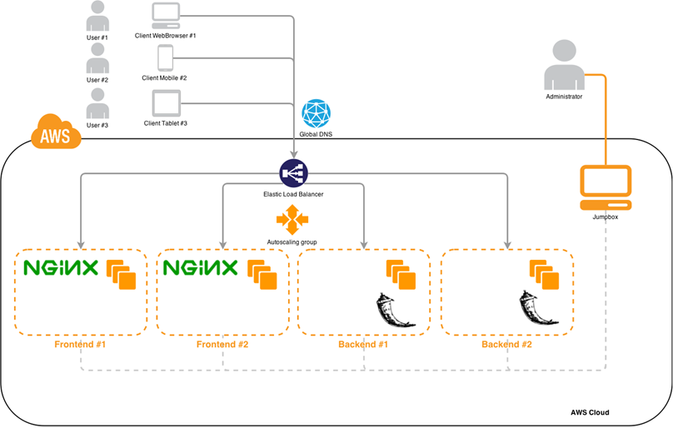

Slide 20
First time, I did it like that!

Slide 21
Then: AWS S3

Slide 22
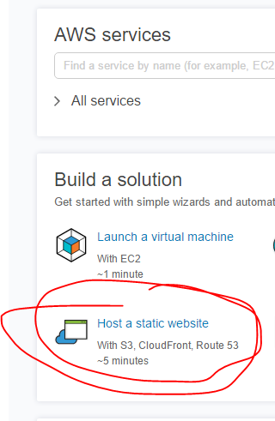
AWS S3
Easy storing of files … many files
Easy exposing of those files as static websites
Scalable

Slide 24
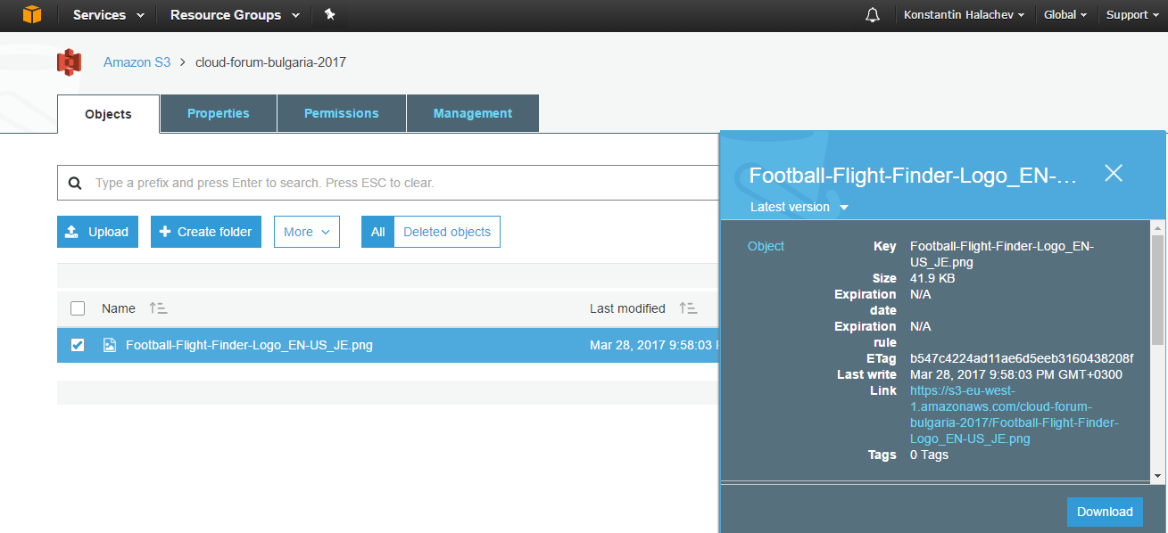
AWS S3

Slide 26
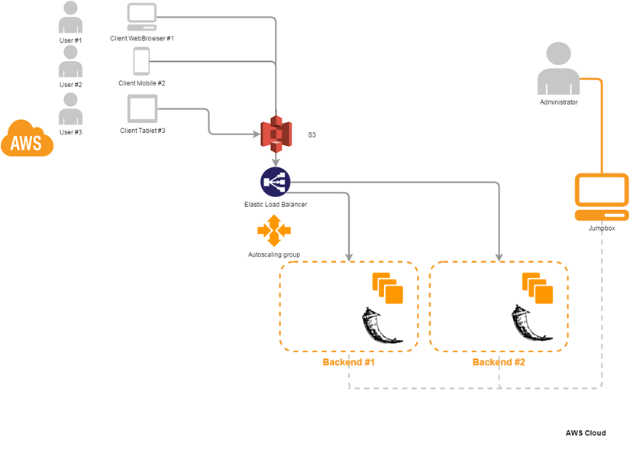

Slide 27
Then: AWS Lambda

Slide 28
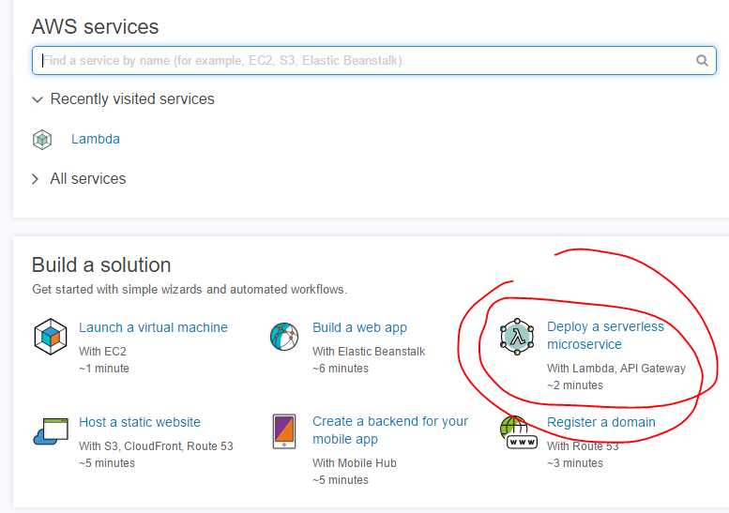
AWS Lambda
Write only code
AWS handles
Deployment
Scaling
Security

Slide 30
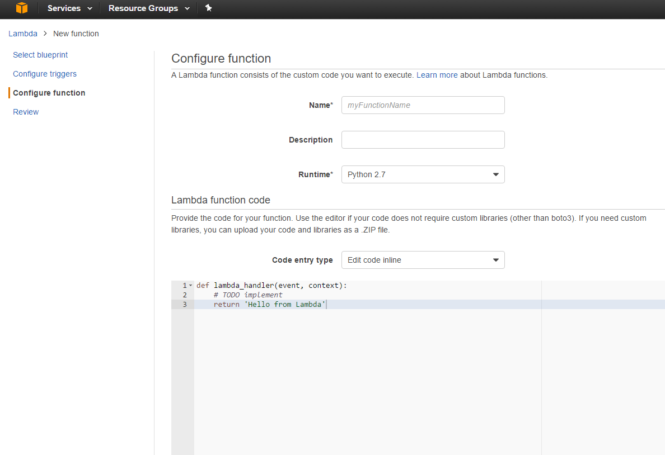
AWS Lambda
Put 200 lines of backend code ->

Slide 31
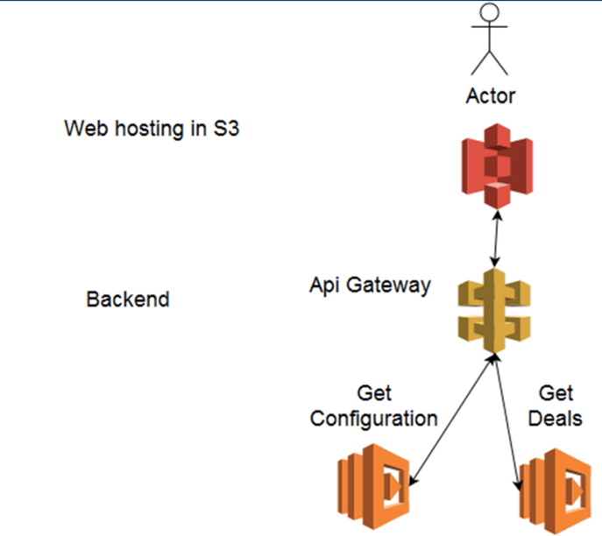

Slide 33
The CL draw day comes

Slide 35
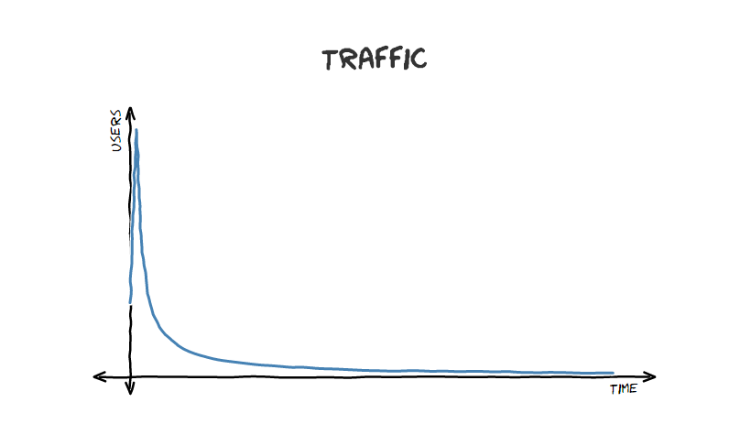
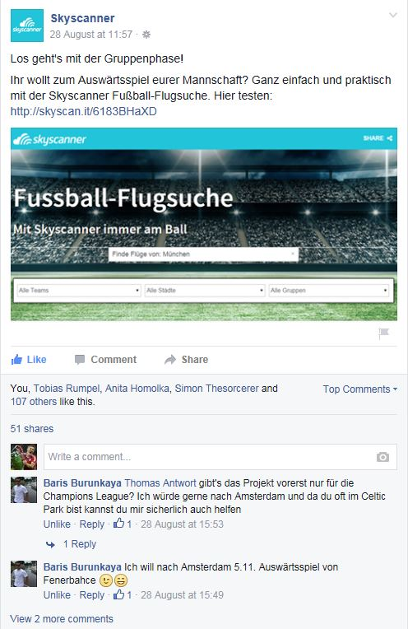
Traffic

Slide 37
Experiment ran for a week with
~ 1000 users per day

Slide 38
Experiment is over: Time for the bill
($+$+$=?)

Slide 39
Costs
S3 hosting S3 Storage: $0.03/GB/Month GET requests: $0.004 per 10,000 requests Data transfer: $0.090 per GB
AWS Lambda every 1,000,000 requests cost 0.20$​ 10,000 1seconds calls to the smallest configs 128MB cost 0.02$
API Gateway $3.50 per million API calls Data transfer $0.09/GB
Disclaimer: correct as of the time of experiment

Slide 40
Cost: < 1$

Slide 41
Cost per 1000 sessions is 11 cents
S3 hosting (5 GET/session,0.5MB/session) 3MB total = 0 5 files per load = $0.02 0.5MB per load = $0.05
AWS Lambda (5 calls per session, <1s/call) $0.001 0.01$
API Gateway (5 calls per session, 2kb/call) $0.02 $0.005
Disclaimer: correct as of the time of experiment

Slide 42
Cost: < 1$
...and many others
https://aws.amazon.com/free

Slide 44
Thank you
Konstantin Halachev
in/konstantinhalachev
@Kontinuit

