Slide 1
CLOUD VR WITH QUARK VR

Slide 2
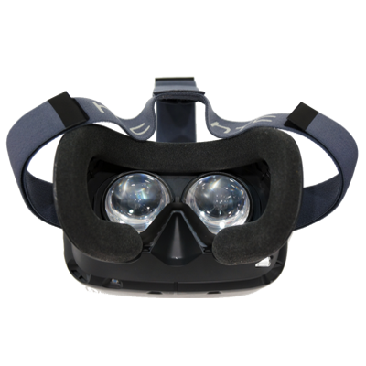
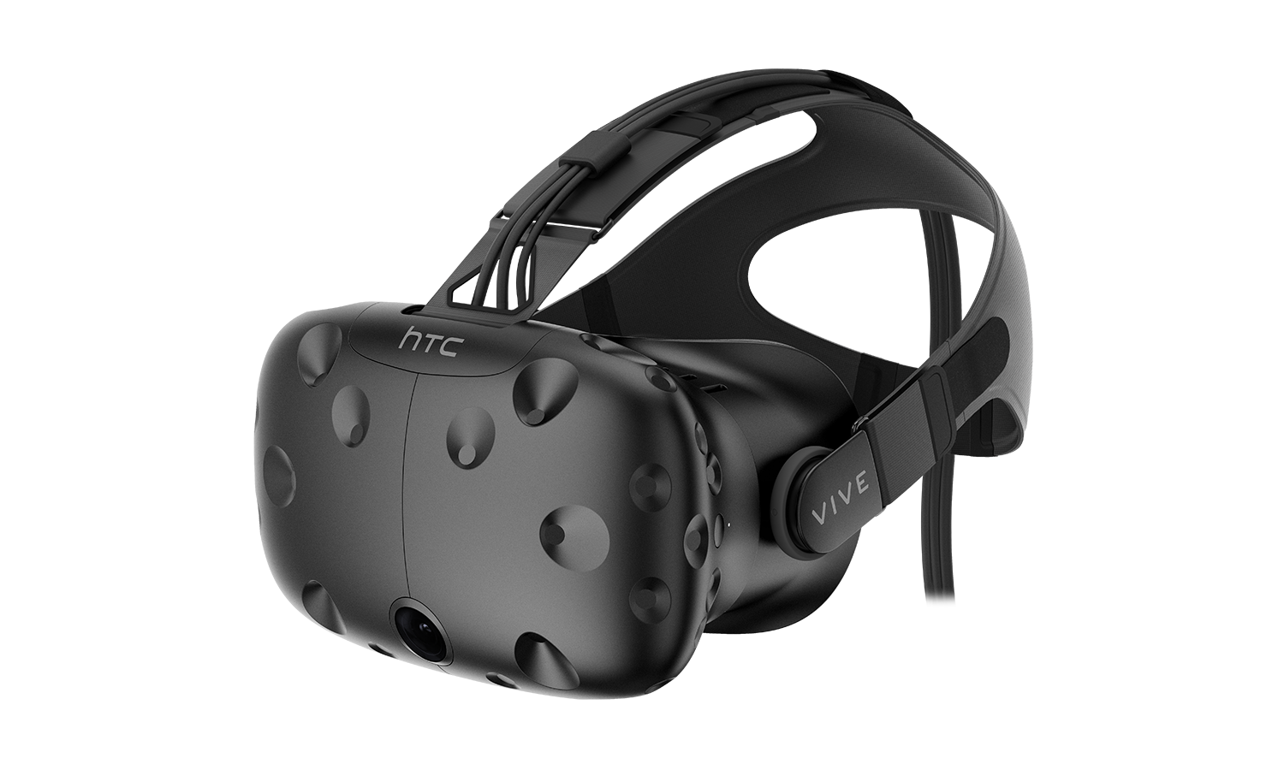
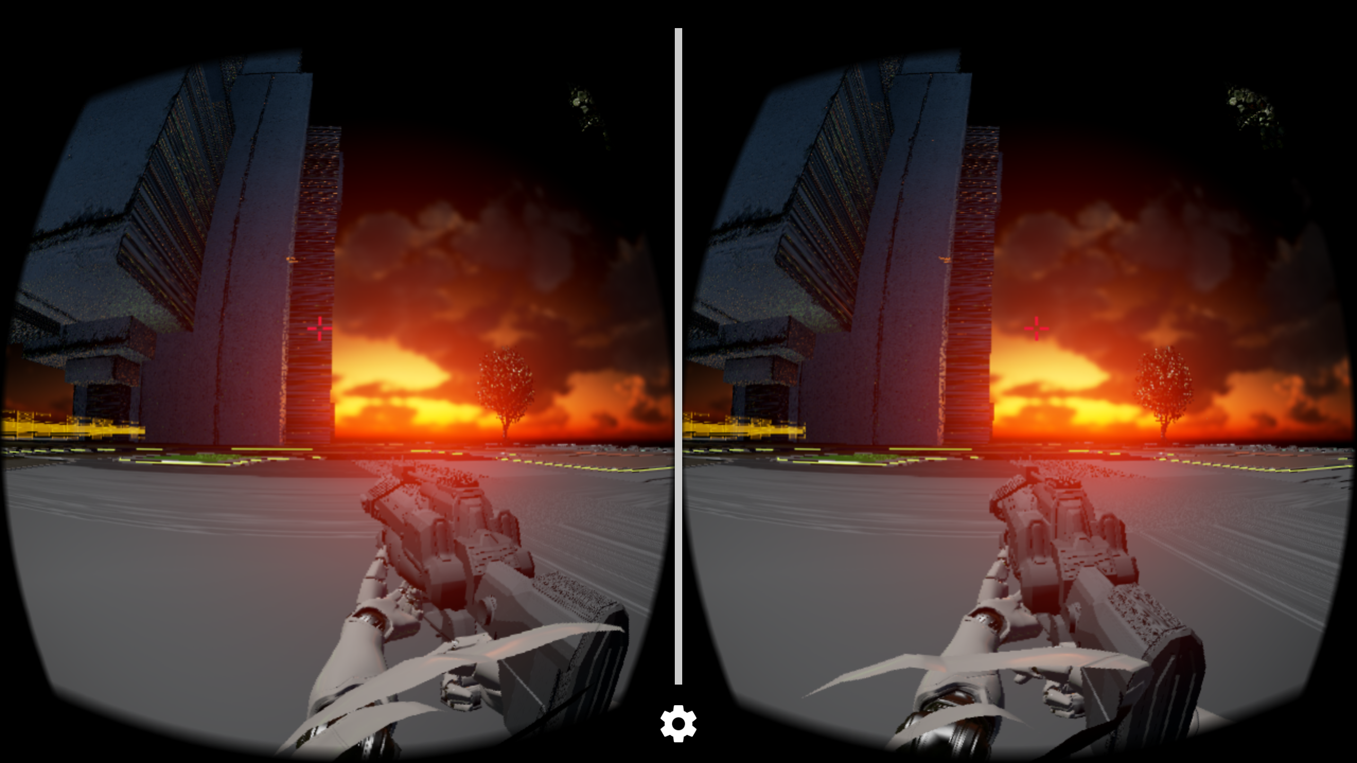
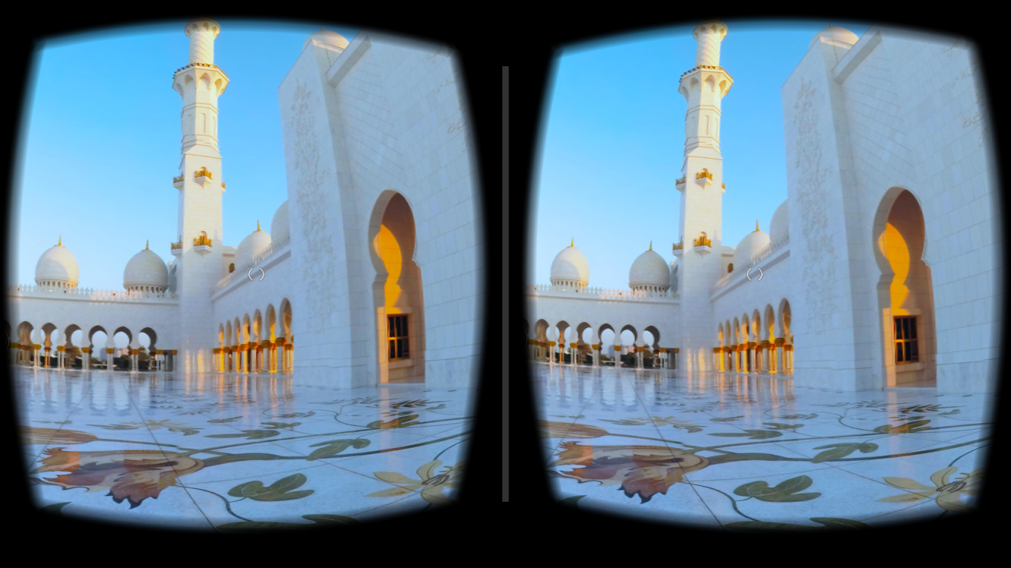
WHAT IS VR?

Slide 3
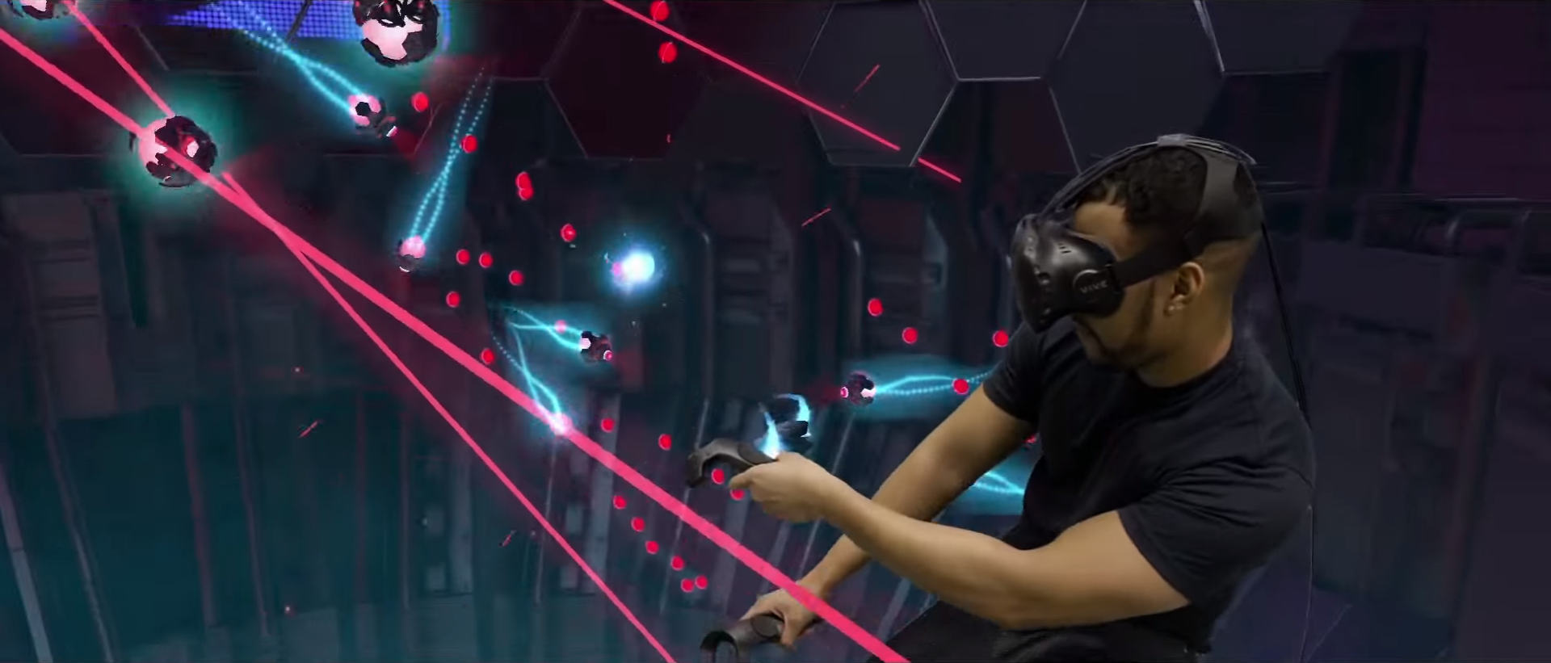
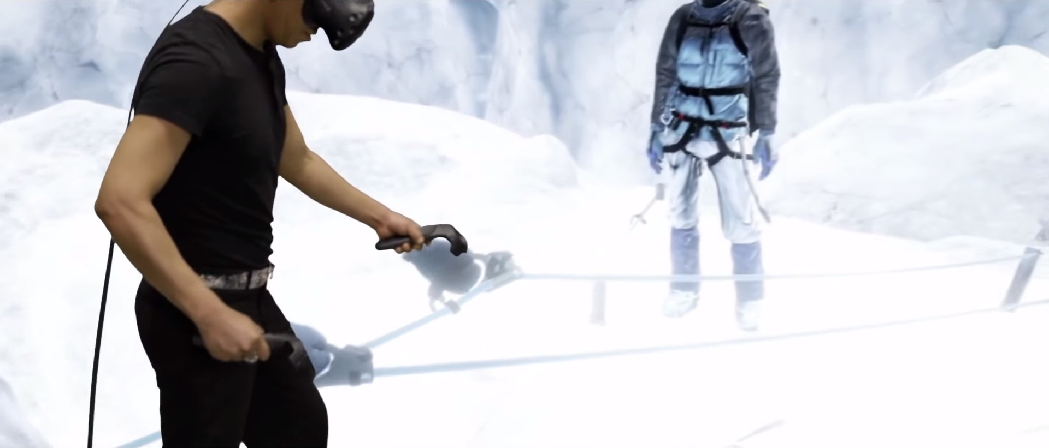
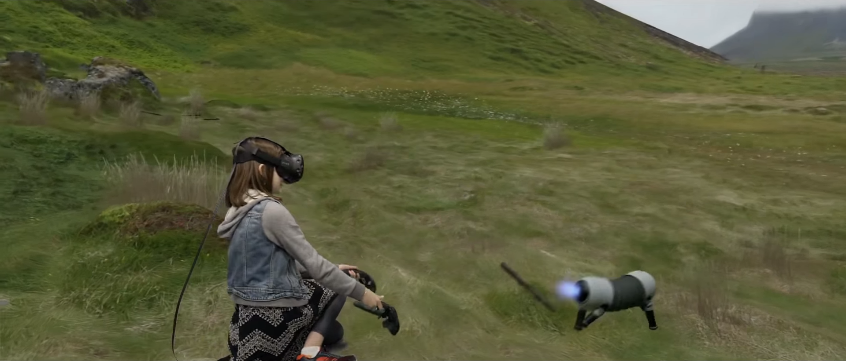
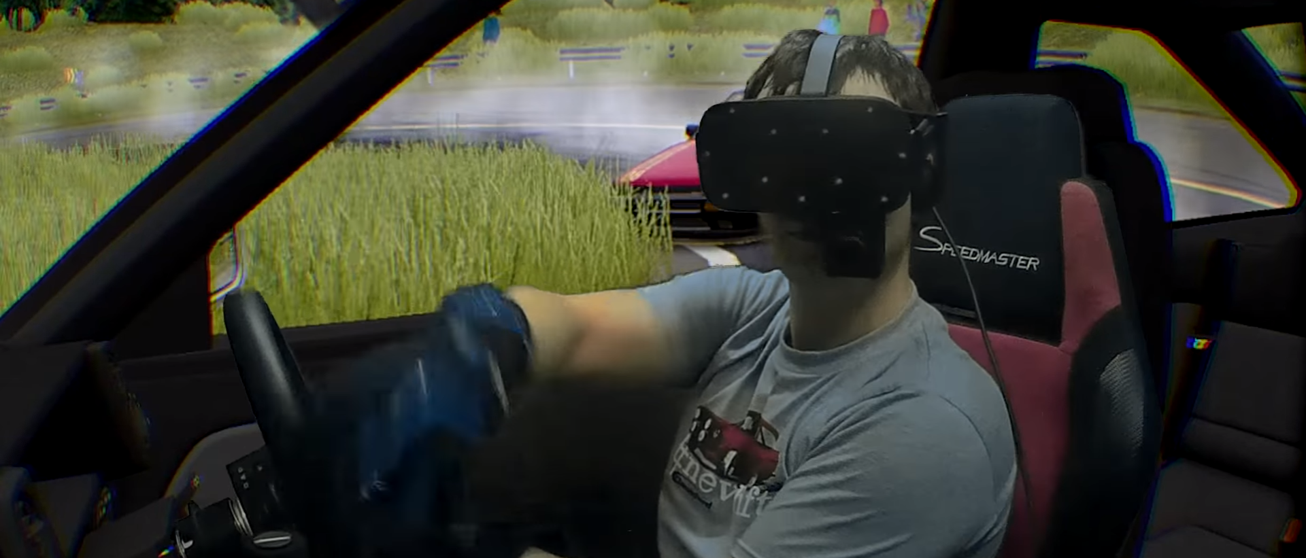
VR OF TODAY: FUN BUT UNFINISHED

Slide 4
THE VR TRILEMMA
VISUAL QUALITY
RESPONSIVENESS
MOBILITY

Slide 5
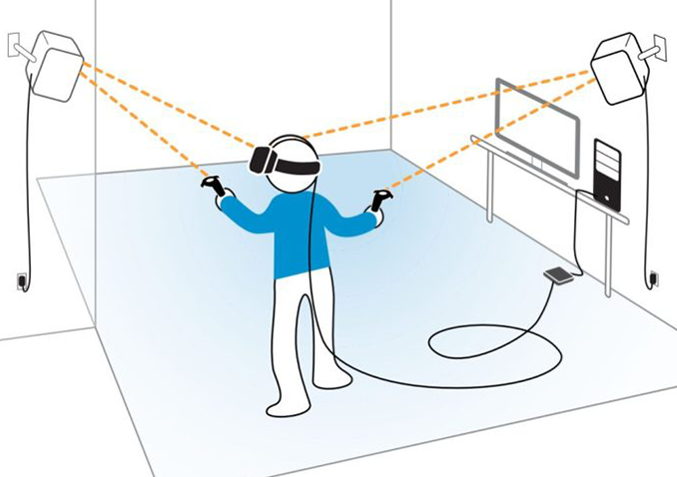
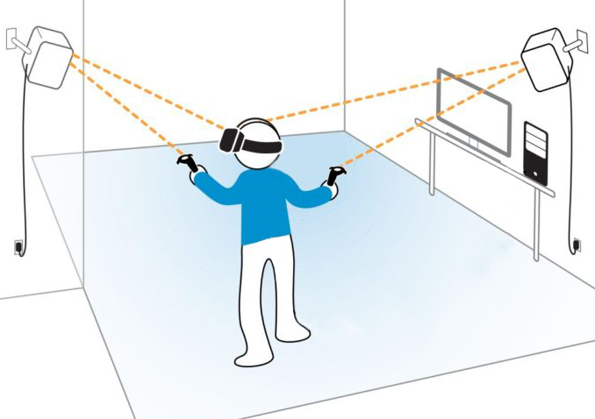
CUT THE CORDS

Slide 8
LIFE BEYOND MOORE’S LAW

Slide 9
WIRELESS HTC VIVE

Slide 10
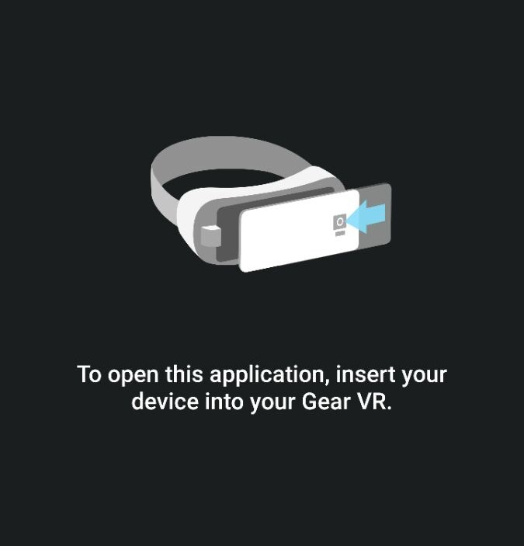
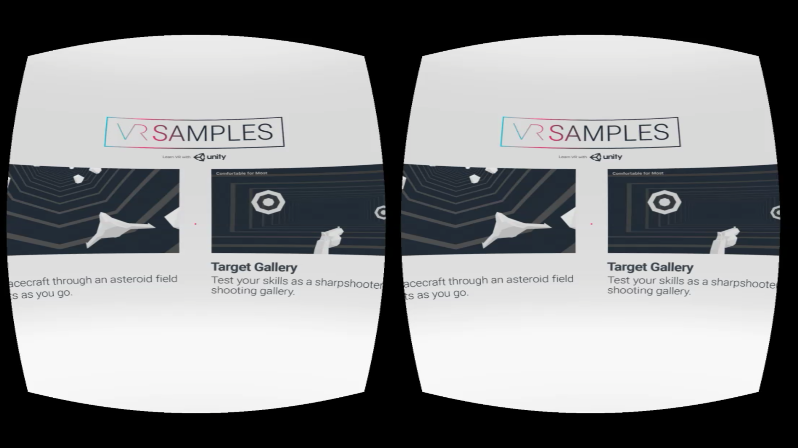
VR REMOTE FOR GEAR VR
Standard testing requires for you to deploy an APK to the phone with every change.
QUARK VR allows for testing on the fly.
DOWNLOAD NOW AT QUARKVR.IO

Slide 11
WIRELESS HTC Vive
An untethered VR experience at 90 FPS with positional tracking
A working prototype already developed

Slide 12
WHY VR WILL CHANGE THE CLOUD
Market penetration of high-end PCs is small
The natural extension of Wireless VR is Cloud VR
The cloud can facilitate the mass adoption of VR

Slide 13
RIPPLE EFFECT
Smartphones have driven the VR technology
VR in turn will change the cloud:
New Media Formats
Higher bandwidth internet
Better GPU Cloud

Slide 14
WHAT’S NEXT?
Create VR arcades with Quark VR
Take a virtual tour in your future home with V-Ray and Quark VR
Bring Quark VR to the Cloud

Slide 15
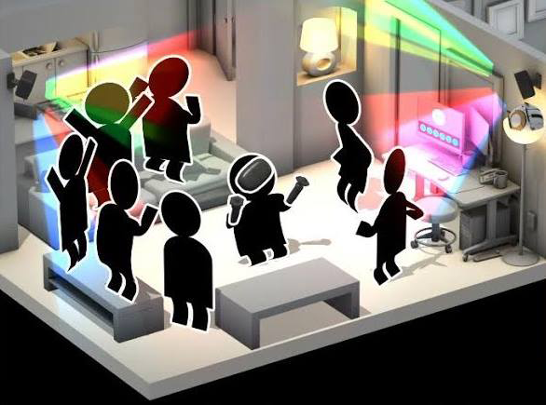
CONTACT US FOR A DEMO
OFFICE@QUARKVR.IO

